Slide 1
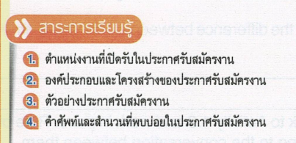
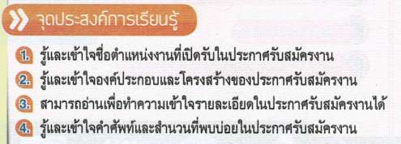

Slide 3
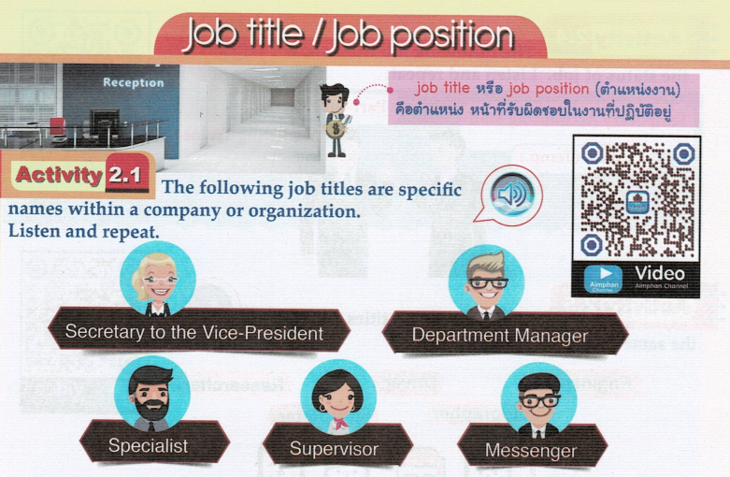

Slide 5
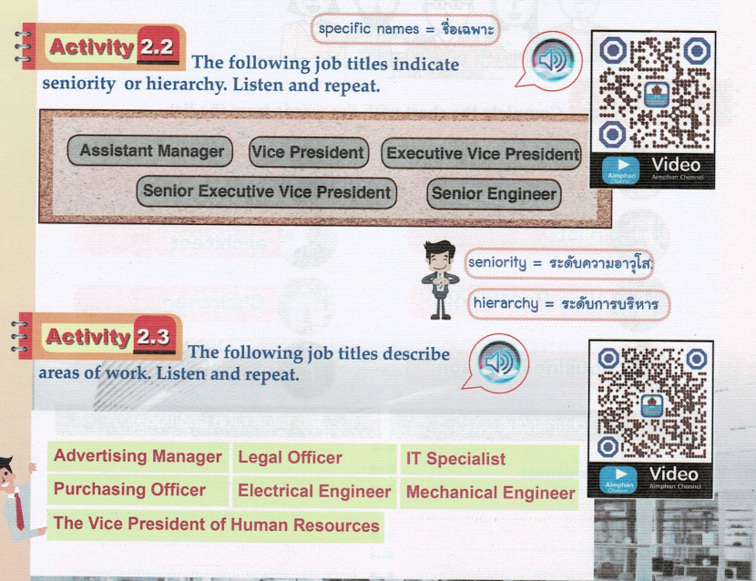

Slide 9
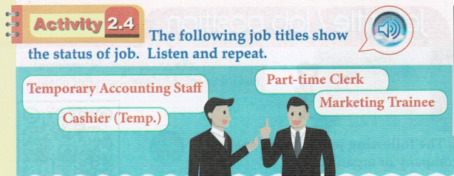

Slide 12
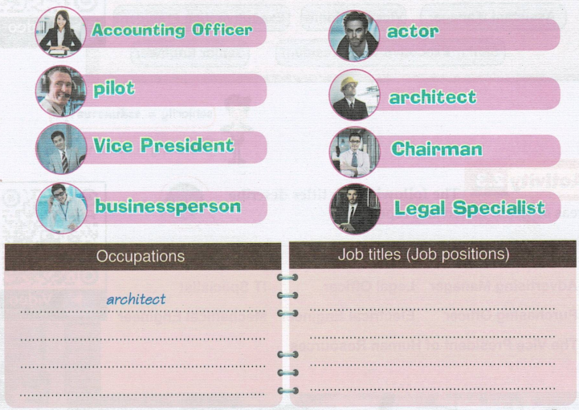
Accounting Officer
actor
Vice President
pilot
Chairman
businessperson
Legal Specialist

Slide 14
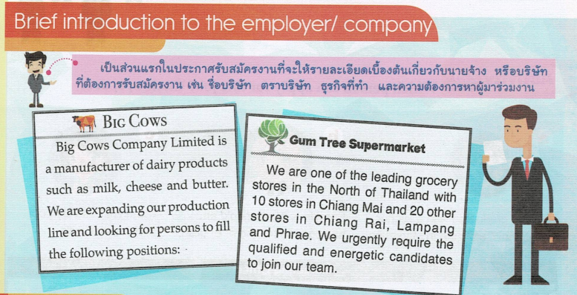

Slide 16
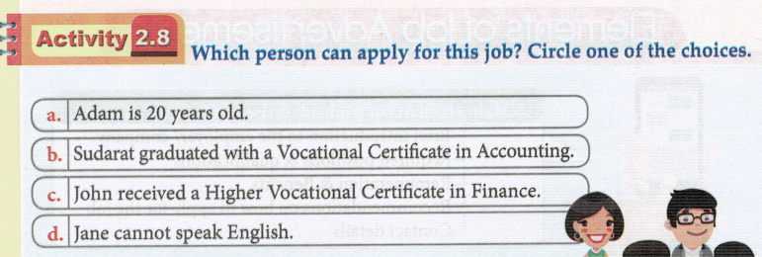

Slide 17
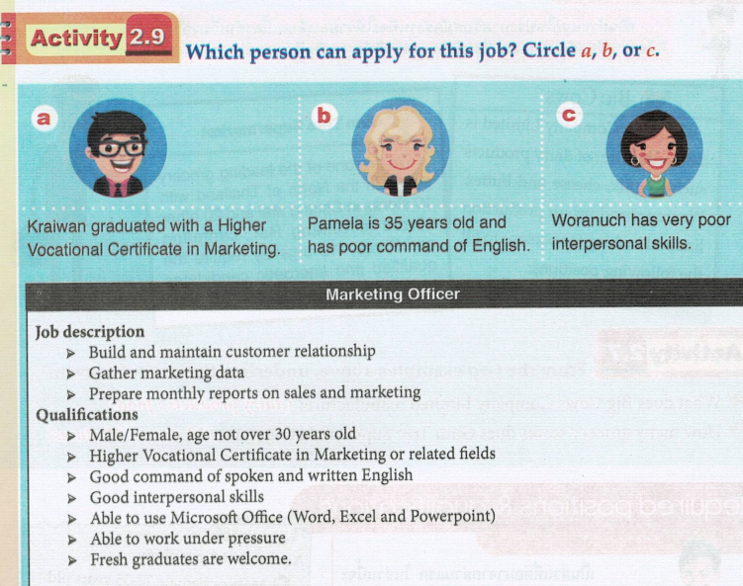

Slide 19
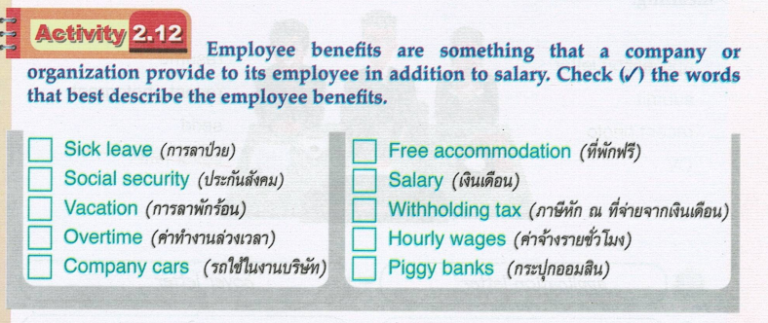

Slide 20
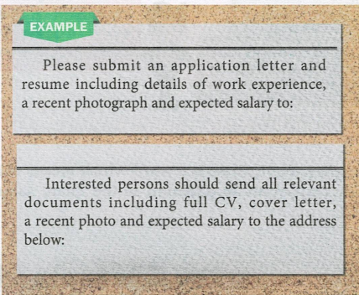
Curriculum Vitae

Slide 21
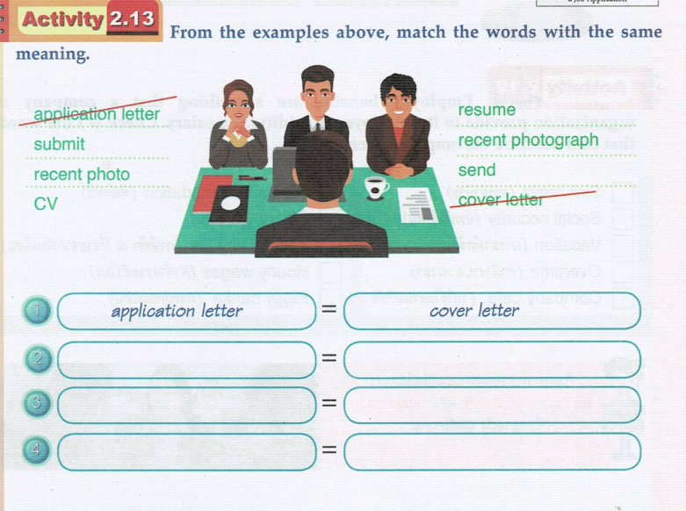
submit
send
recent photo
recent photograph
CV
resume

Slide 22
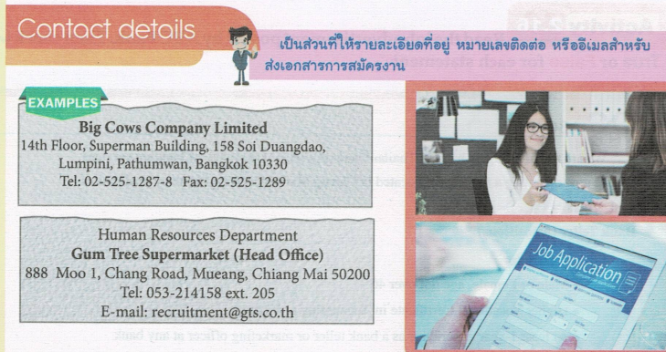
extension

Slide 26
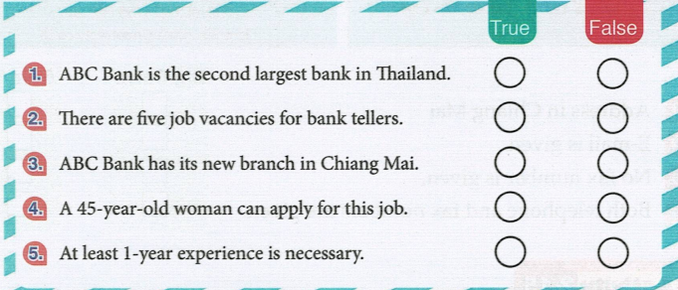

Slide 28
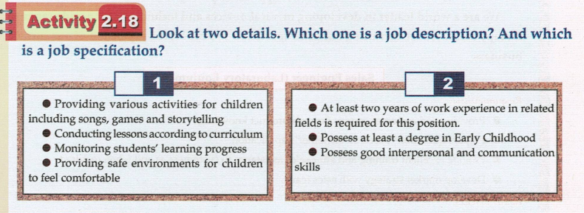
Job description
job specification

Slide 30
True
True
False
True

Slide 32
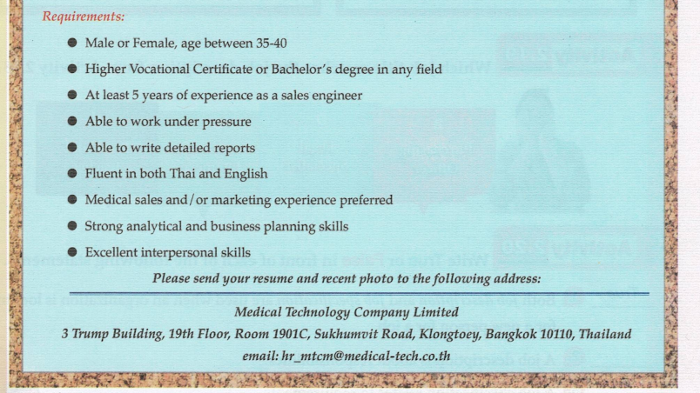

Slide 33
This job advertisement belongs to Medical Technology Company Limited.
: Medical Technology Company Limited has some vacancies for sales engineers at the moment

Slide 34
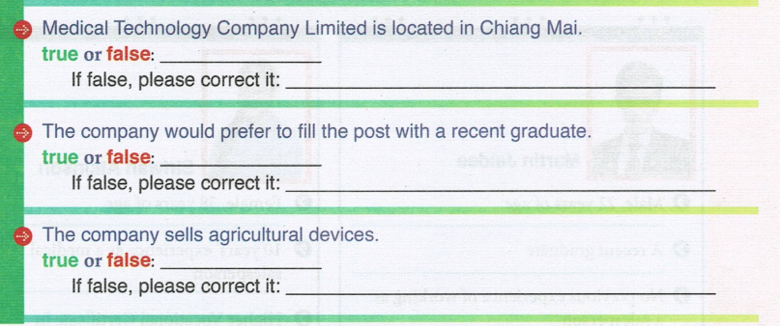
Medical Technology Company Limited is located in Bangkok.
The company would prefer to fill the post with an experienced person.
The company sells medical devices.

Slide 35
- Provide good customer service through product knowledge
- Prepare quotations based on customer’s application
- Provide excellent training and after-sales assistance to customers as and when required
- Develop market strategy with sales teams
- Male or Female, age between 35-40
- Higher Vocational Certificate or Bachelor’s degree in any field
- At least 5 years of experience as a sales engineer
- Able to work under pressure

Slide 36
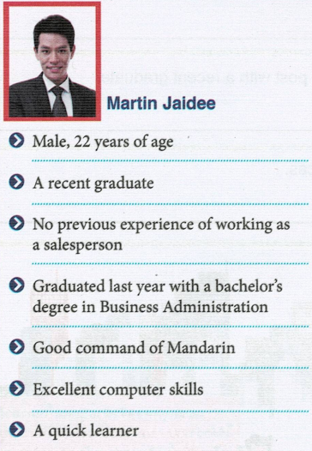
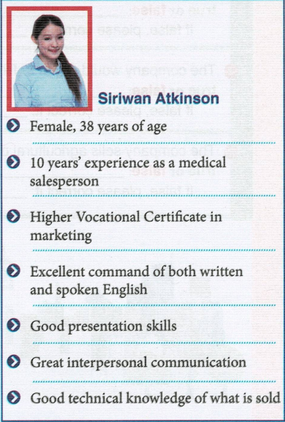

Slide 37
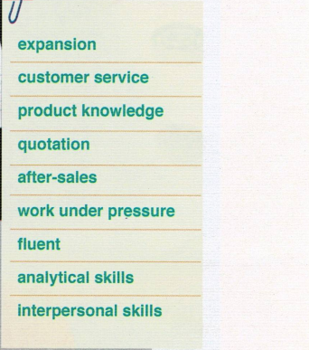

Slide 41
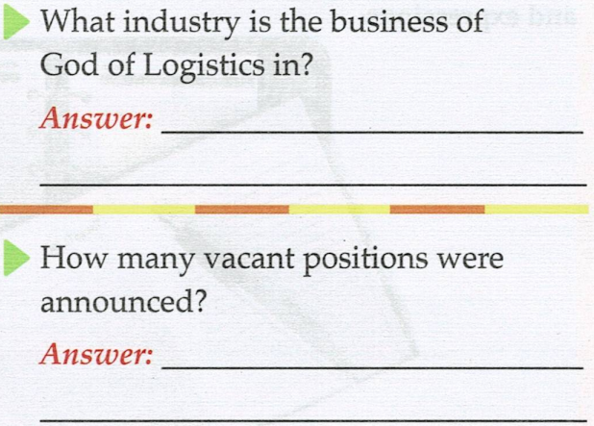
transport and logistics
two

Slide 42
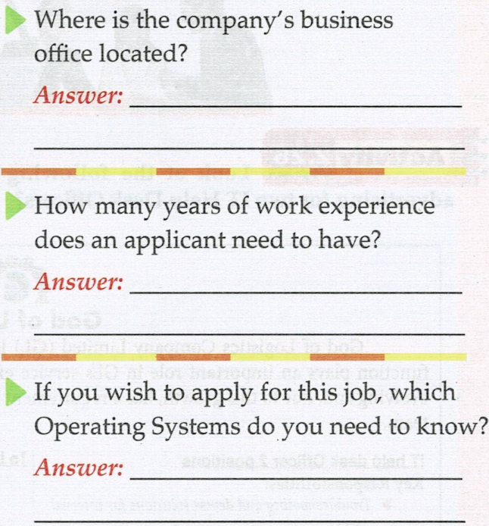
Bangkok
two years
Windows 7 & Windows 10

Slide 44
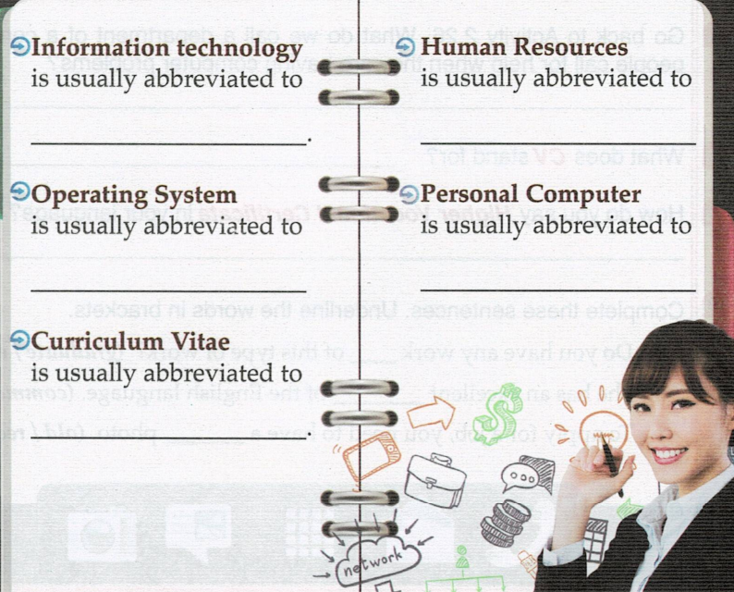
IT
HR
OS
PC
CV

Slide 45
Department Manager
Assistant Manager

Slide 46
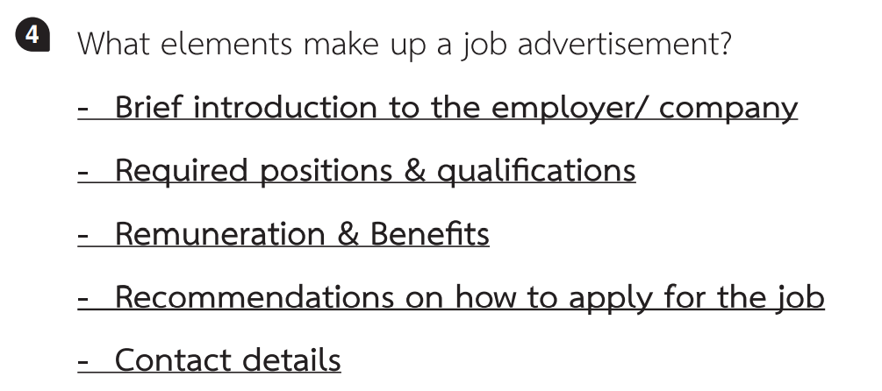

Slide 50
ไกรวัล ศรีประทักษ์ และคณะ.ภาษาอังกฤษเตรียมความพร้อมเพื่อการทำงาน.กรุงเทพฯ;เอมพันธ์,2563

