Slide 1

Testing Fluid Properties: Measurement, Principles, and Analysis
Understanding fluid properties is fundamental to engineering excellence. This comprehensive guide explores the essential techniques, principles, and methodologies for measuring and analyzing fluid behavior in various applications.

Slide 2

Introduction to Fluid Properties
What Are Fluids?
Fluids are substances that flow and conform to the shape of their container, encompassing both liquids and gases. Unlike solids, fluids cannot maintain a fixed shape and will deform continuously under applied shear stress.
Essential Properties
Density - mass per unit volume
Viscosity - resistance to flow
Surface tension - intermolecular forces
Vapor pressure - tendency to evaporate
Understanding these fundamental properties is crucial for engineering applications, experimental analysis, and process optimization. Each property influences how fluids behave under different conditions and affects system performance.

Slide 3
Fundamentals of Fluid Mechanics
Fluid Statics
Fluid Dynamics
Viscous Forces
Study of fluids at rest, focusing on pressure distribution and hydrostatic forces acting on surfaces and structures.
Analysis of fluids in motion, examining velocity fields, acceleration, and the forces causing fluid movement.
Internal friction forces that resist flow, creating shear stress between adjacent fluid layers moving at different velocities.
The no-slip condition is fundamental to understanding viscous flow - fluid particles adjacent to solid boundaries have zero velocity relative to the surface. This creates velocity gradients and characteristic flow profiles. The Reynolds number serves as the critical parameter distinguishing between smooth laminar flow and chaotic turbulent flow regimes.

Slide 4



Principles of Viscosity
Internal Friction
Newton's Law
Flow Resistance
Viscosity represents the internal resistance of fluid layers sliding past each other, caused by intermolecular forces and momentum transfer.
For Newtonian fluids, shear stress is directly proportional to the velocity gradient: τ = μ(du/dy), where μ is dynamic viscosity.
Higher viscosity increases energy losses in pipes and equipment, affecting pump requirements and system efficiency significantly.
Consider fluid flow between two parallel plates: when one plate moves relative to the other, viscous shear creates a linear velocity profile. This fundamental concept helps engineers predict flow behavior and calculate pressure drops in practical applications.

Slide 5




Devices for Measuring Flow and Pressure
Differential Pressure
Positive Displacement
Orifice plates, venturi meters, and flow nozzles measure flow by creating controlled pressure drops. They're reliable, cost-effective, and suitable for most clean fluids.
Oval gear and nutating disc meters mechanically measure precise volumes by trapping and counting fluid portions. Ideal for viscous fluids and custody transfer.
Turbine Flowmeters
Ultrasonic Technology
Rotating turbine blades generate pulse signals proportional to flow rate. They offer excellent accuracy and repeatability for clean, low-viscosity applications.
Non-intrusive measurement using transit time or Doppler shift principles. Perfect for large pipes, corrosive fluids, or applications requiring no pressure drop.
Selection depends on fluid properties, accuracy requirements, pressure drop constraints, and maintenance considerations. The fundamental relationship Q = V × A (flow rate equals velocity times cross-sectional area) underlies all measurement principles.

Slide 6
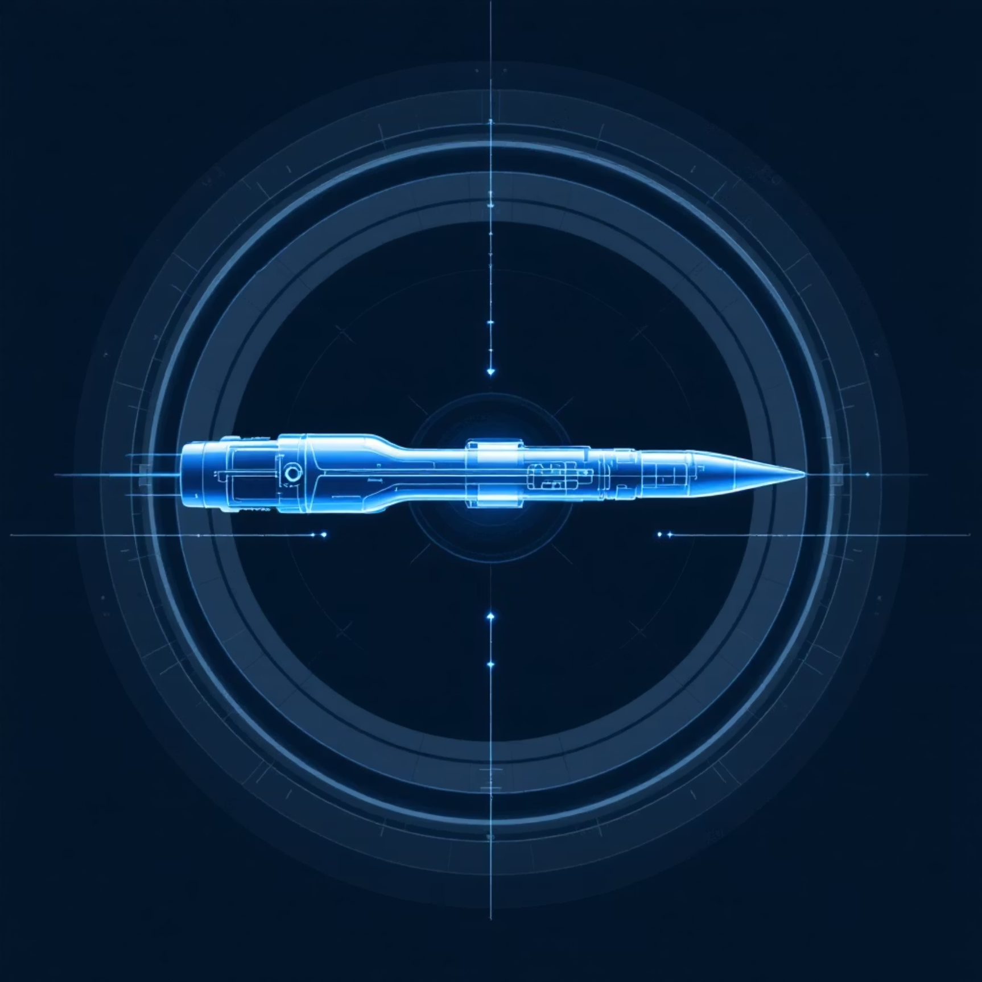

Measuring Flow Rate and Velocity
Velocity Measurement Techniques
Pitot Tubes: Direct velocity measurement using stagnation pressure
Laser Doppler Anemometry: Non-intrusive optical velocity measurement
Hot Wire Anemometry: Thermal sensors for turbulence studies
Particle Image Velocimetry: Whole-field velocity mapping
Flow Rate Types
Volumetric Flow Rate: Volume per unit time (m³/s)
Mass Flow Rate: Mass per unit time (kg/s)
Accurate measurements require steady-state conditions and homogeneous fluid properties. Turbulent flows present unique challenges due to velocity fluctuations, requiring time-averaged measurements or specialized turbulence-capable sensors.
Critical Consideration: Multiphase flows (gas-liquid mixtures) require specialized measurement techniques and careful calibration to account for varying fluid properties and flow patterns.

Slide 7
Analyzing Energy Losses in Pipes and Devices
01
02
Friction Losses
Minor Losses
Major losses due to wall friction calculated using the Darcy-Weisbach equation: hf = f(L/D)(V²/2g). Friction factor depends on Reynolds number and pipe roughness.
Losses from fittings, valves, bends, and area changes. Calculated as hm = K(V²/2g), where K is the loss coefficient specific to each component.
03
04
Turbulence Effects
System Analysis
Turbulent flow increases energy dissipation through chaotic velocity fluctuations and enhanced mixing. Higher Reynolds numbers generally increase losses.
Total system losses combine all components. Pump sizing and energy costs depend on accurate loss calculations for economic operation.
Energy losses directly impact system efficiency and operating costs. Understanding loss mechanisms enables engineers to optimize pipe layouts, select appropriate components, and minimize energy consumption in fluid systems.

Slide 8
Evaluating Experimental Accuracy
Fluid Preparation
Installation Requirements
Ensure fluid cleanliness, degassing, and thermal equilibrium. Contamination and air bubbles significantly affect measurement accuracy and repeatability.
Maintain adequate straight pipe lengths upstream and downstream of sensors. Typically 10-20 diameters upstream and 5 diameters downstream for flow meters.
Flow Development
Calibration Protocols
Allow sufficient length for velocity profile development. Disturbed flow patterns from bends or valves can cause significant measurement errors.
Regular sensor calibration with traceable standards. Temperature and pressure compensation for changing fluid properties during testing.
Systematic error analysis includes uncertainty quantification, statistical analysis of repeated measurements, and validation against theoretical predictions. Proper experimental design and rigorous methodology ensure reliable, reproducible results for engineering applications.

Slide 9
Case Studies and Applications
Water Treatment
Automotive Industry
Pharmaceutical Manufacturing
Municipal water systems rely on accurate flow monitoring for chemical dosing, filtration rates, and distribution network management. Precise measurements ensure water quality and regulatory compliance.
Fuel injection systems require precise flow control for optimal combustion efficiency and emission reduction. Advanced flow sensors enable real-time engine management and performance optimization.
Critical gas flow control in clean rooms and reaction vessels ensures product quality and worker safety. Sterile processing demands non-contaminating measurement techniques.
Each application presents unique challenges requiring specialized measurement approaches. Success depends on understanding fluid properties, selecting appropriate instrumentation, and implementing robust quality control procedures to maintain measurement integrity.

Slide 10








Conclusion: The Critical Role of Fluid Property Testing
Understanding Properties
Precise Measurement
Comprehensive knowledge of density, viscosity, and flow behavior forms the foundation for all fluid applications.
Advanced instrumentation and rigorous methodology ensure accurate, reliable data for engineering design and analysis.
Future Innovation
Energy Optimization
Emerging technologies like smart sensors, IoT integration, and AI-driven analysis promise enhanced monitoring capabilities.
Accurate loss calculations enable system optimization, reducing energy consumption and operational costs significantly.
The future of fluid mechanics lies in the integration of advanced sensors, real-time monitoring systems, and computational fluid dynamics. This convergence will enable unprecedented precision in fluid property testing and system optimization.
Rigorous experimental practice remains essential for generating reliable data that drives engineering innovation. As systems become more complex and efficiency demands increase, the importance of precise fluid property testing continues to grow, making it an indispensable tool for modern engineering excellence.

