Slide 1
Lubricant Testing: Fundamentals and Quality Assessment
In the world of mechanical engineering and industrial maintenance, lubricant testing plays a pivotal role in ensuring the longevity and efficiency of machinery. This presentation delves into the essential properties of lubricants, the equipment used for testing, and strategies for evaluating their quality. By understanding these elements, engineers and technicians can select the optimal lubricants for specific applications, preventing failures, reducing wear, and minimizing operational costs.
Key properties we will explore include viscosity, flash point, and pour point, which directly influence a lubricant's performance under varying temperatures and loads. Testing equipment ranges from viscometers to flash point testers, each designed to measure specific characteristics accurately. Ultimately, quality assessment guides the selection process, ensuring lubricants meet industry standards like those set by ASTM. This knowledge not only enhances equipment reliability but also supports sustainable practices by extending service life and reducing waste.

Slide 2
Types and Properties of Lubricants
Lubricants are critical for reducing friction and wear in mechanical systems. They typically consist of three main components: base oil, which forms the bulk (70-99%) and provides the primary lubricating film; thickeners, used in greases to achieve semi-solid consistency; and additives, which enhance specific properties like oxidation resistance or anti-wear capabilities. Base oils are categorized into mineral (from petroleum), synthetic (chemically engineered for superior performance), and bio-based (renewable sources), each offering unique advantages in temperature stability and environmental impact.
Essential properties include viscosity, the measure of a lubricant's resistance to flow, which ensures proper film thickness; flash point, the temperature at which vapors ignite, indicating safety in high-heat environments; pour point, the lowest temperature at which the oil flows, vital for cold starts; and mechanical stability, the ability to withstand shear forces without breaking down. For instance, synthetic lubricants often exhibit better mechanical stability, making them ideal for high-speed applications. Understanding these properties allows for informed selection, optimizing performance and preventing issues like inadequate lubrication or thermal degradation.
Base Oil
Thickeners
Additives
Foundation of the lubricant, determining core flow characteristics.
Convert oils to greases for better adhesion in bearings.
Improve oxidation resistance, detergency, and anti-foam properties.

Slide 3
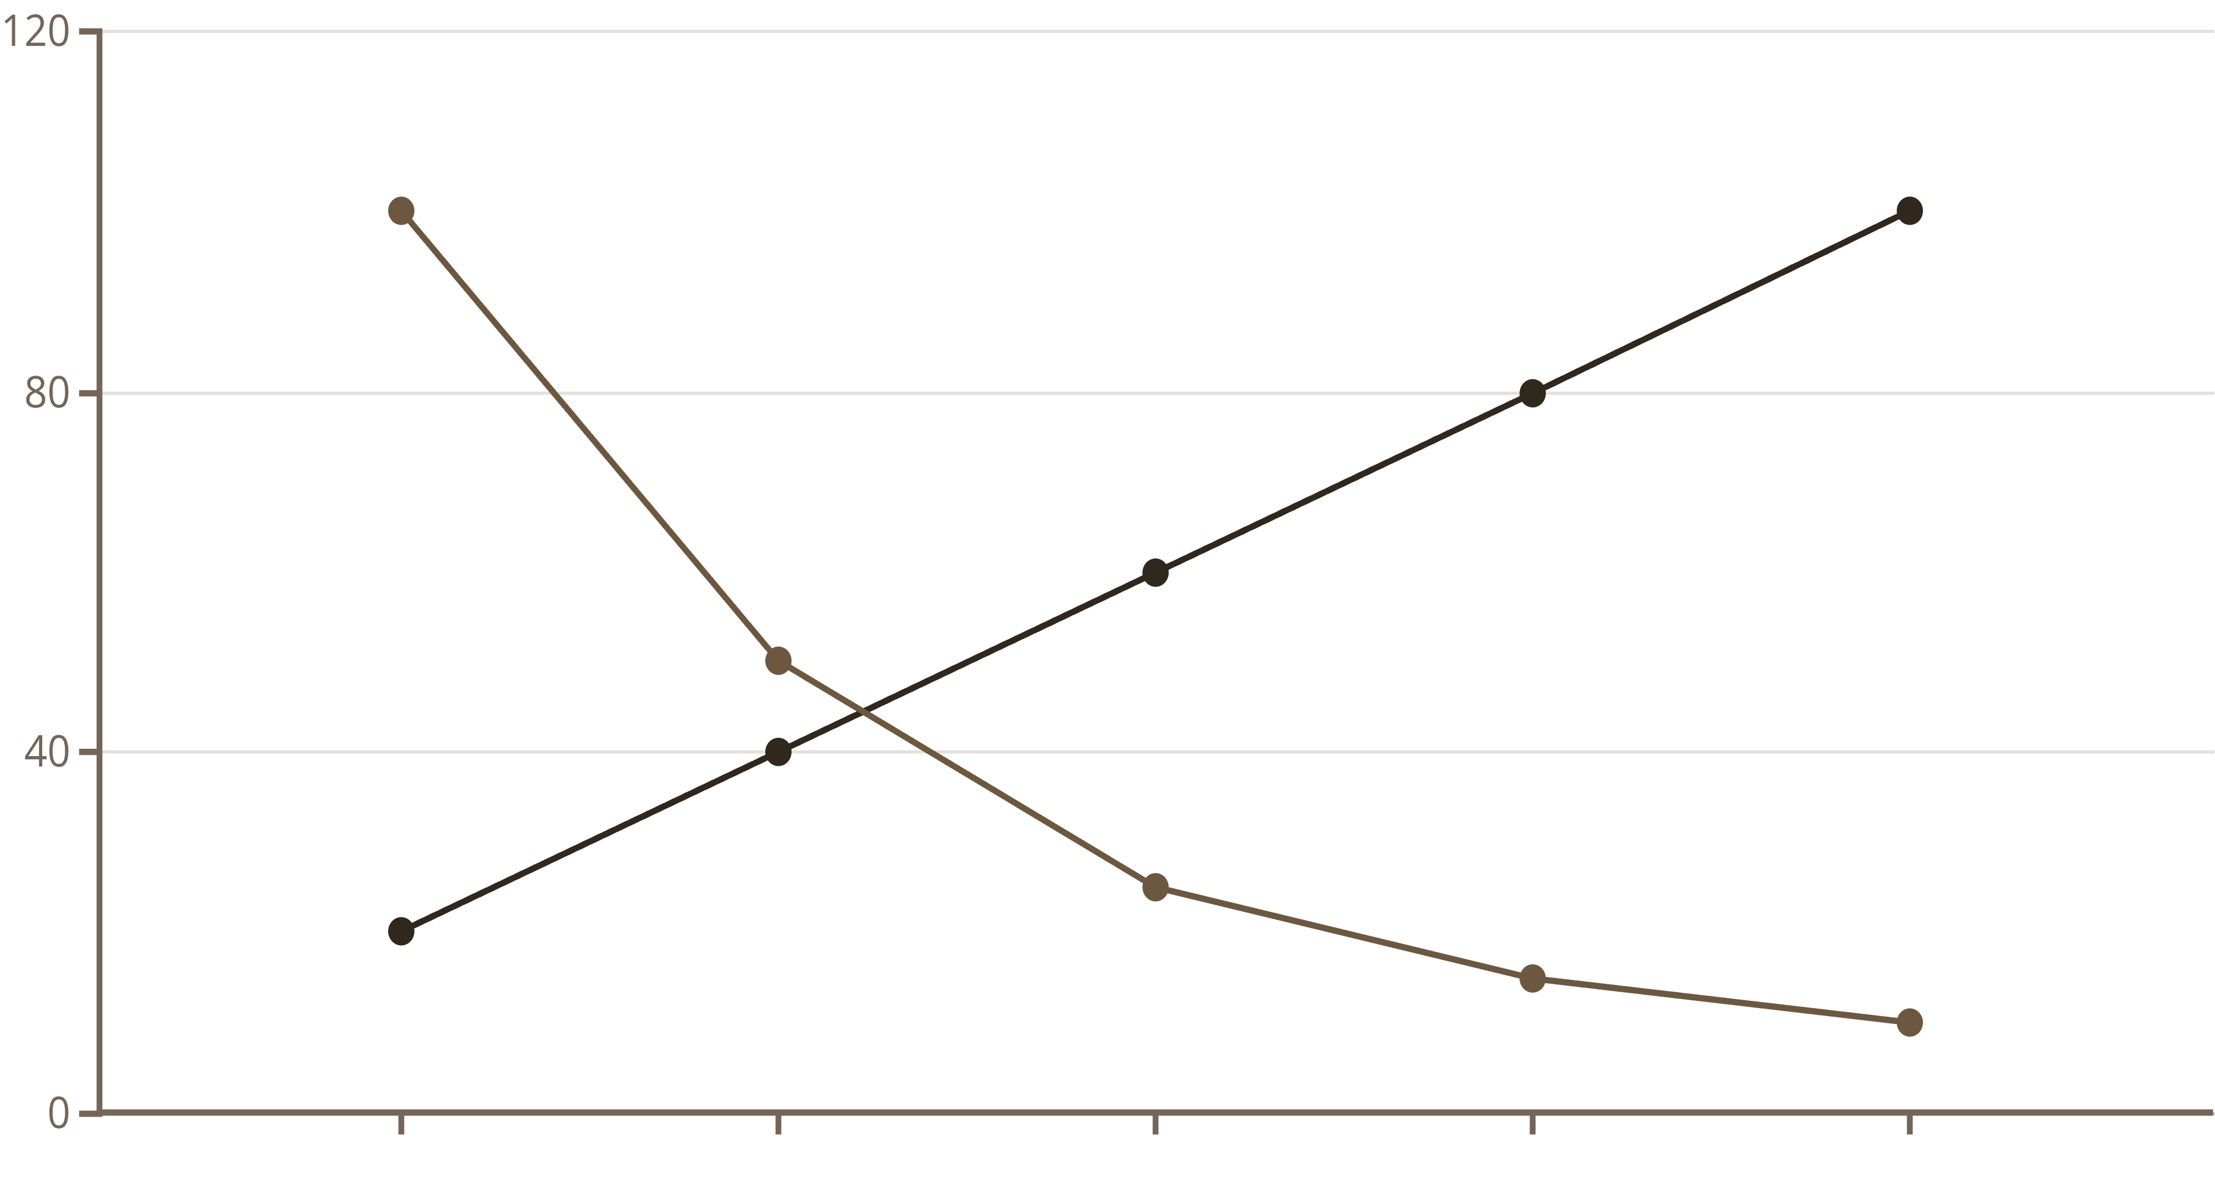
Viscosity: The Core of Lubrication
Viscosity is the cornerstone property of any lubricant, quantifying its internal resistance to flow and ability to form a protective film between moving parts. It is standardized under ASTM D445, measured in centistokes (cSt) at 40°C for low-temperature behavior and 100°C for high-temperature performance. High-viscosity oils create robust films in heavy-load, high-speed scenarios, preventing metal-to-metal contact, while low-viscosity options suit lighter duties to avoid excessive drag and energy loss.
Temperature profoundly affects viscosity; as it rises, viscosity decreases, following the Walther equation for non-linear behavior. This is why multi-grade oils, like SAE 10W-40, use viscosity index improvers to maintain consistency across a wide range. Selecting the right viscosity grade—based on equipment specifications, operating conditions, and environmental factors—ensures optimal lubrication. For example, in automotive engines, improper viscosity can lead to increased fuel consumption or accelerated wear. Regular testing monitors degradation, as oxidized oils thicken over time, compromising efficiency.
Temperature (°C)
Viscosity (cSt)
This chart illustrates typical viscosity decline with rising temperature, emphasizing the need for temperature-stable formulations.

Slide 4
Flash Point and Pour Point: Safety and Flow Limits
The flash point, defined as the lowest temperature at which lubricant vapors ignite when exposed to an open flame, is a critical safety metric per ASTM D92 (Cleveland Open Cup) or D56 (Tag Closed Cup). It indicates volatility and fire risk; higher values (e.g., 315°F or 157°C for heavy industrial oils) mean safer operation in hot environments like engines or turbines. Low flash points signal contamination or degradation, potentially leading to hazardous conditions.
Conversely, the pour point (ASTM D97) is the temperature below which the oil ceases to flow under gentle agitation, crucial for cold-weather performance. Values as low as -21°C ensure startups in arctic conditions without pump failures. These properties interrelate: paraffinic oils offer high flash points but higher pour points, while naphthenic types excel in low temperatures but may compromise volatility. Testing these ensures lubricants match operational extremes, preventing issues like seized components or ignition risks. For marine applications, oils with flash points above 200°C are mandated for safety.
Flash Point Testing
Pour Point Testing
Measures ignition risk; essential for high-heat machinery.
Assesses cold flow; vital for winter operations.
ASTM D92: Open cup method for heavier oils
ASTM D97: Cooling and observation technique
High values indicate thermal stability
Low values prevent solidification

Slide 5




Essential Equipment for Lubricant Testing
Accurate lubricant evaluation relies on specialized equipment tailored to key properties. Capillary viscometers, like the Cannon-Fenske, measure kinematic viscosity by timing oil flow through a calibrated tube under gravity, ideal for low-shear applications. Rotary viscometers, such as Brookfield models, assess dynamic viscosity by rotating a spindle in the sample, providing data for non-Newtonian fluids like greases.
Flash point testers, including automated Cleveland Open Cup devices, heat samples incrementally while detecting ignition with a flame or arc. Pour point testers cool samples in a controlled bath, checking flow at 3°C intervals. For greases, the penetrometer (ASTM D217) drops a cone into the sample to gauge consistency, classifying by NLGI grades from 000 (fluid) to 6 (hard). These tools ensure compliance with standards, enabling precise quality control. Modern digital versions offer automation, reducing errors and enhancing repeatability in industrial labs.
Capillary Viscometer
Rotary Viscometer
Precise flow measurement for base oils.
Shear testing for complex lubricants.
Flash Point Tester
Pour Point Tester
Safety evaluation under heat.
Cold performance assessment.

Slide 6





Testing Viscosity and Grease Stability
Viscosity testing for oils follows ASTM D445 protocols, but for greases, penetration testing (ASTM D217) uses a penetrometer to measure how deeply a 100g cone sinks into the sample after 5 seconds, determining NLGI grade. This assesses consistency: Grade 2, for example, offers semi-fluid properties for general bearing lubrication. Stability under shear is evaluated by worked penetration, simulating operational mixing.
Dropping point testing (ASTM D2265) heats grease in a cup until a drop falls from the bottom, indicating liquefaction temperature—critical for high-heat applications where greases must retain structure up to 500°F. The water washout test (ASTM D1264) exposes grease to water spray under rotation, measuring weight loss to evaluate water resistance in wet environments. These tests reveal how lubricants endure mechanical stress, contamination, and thermal cycling, ensuring reliability. Poor stability can lead to lubricant migration or failure, increasing maintenance needs. Regular testing tracks formulation efficacy, guiding improvements like advanced thickener selections.
Water Washout
Assess washout resistance
Dropping Point
Determine softening point
Penetration Test
Measure cone penetration
Sample Prep
Condition and load sample
This diagram outlines the interconnected testing sequence for comprehensive grease evaluation.

Slide 7
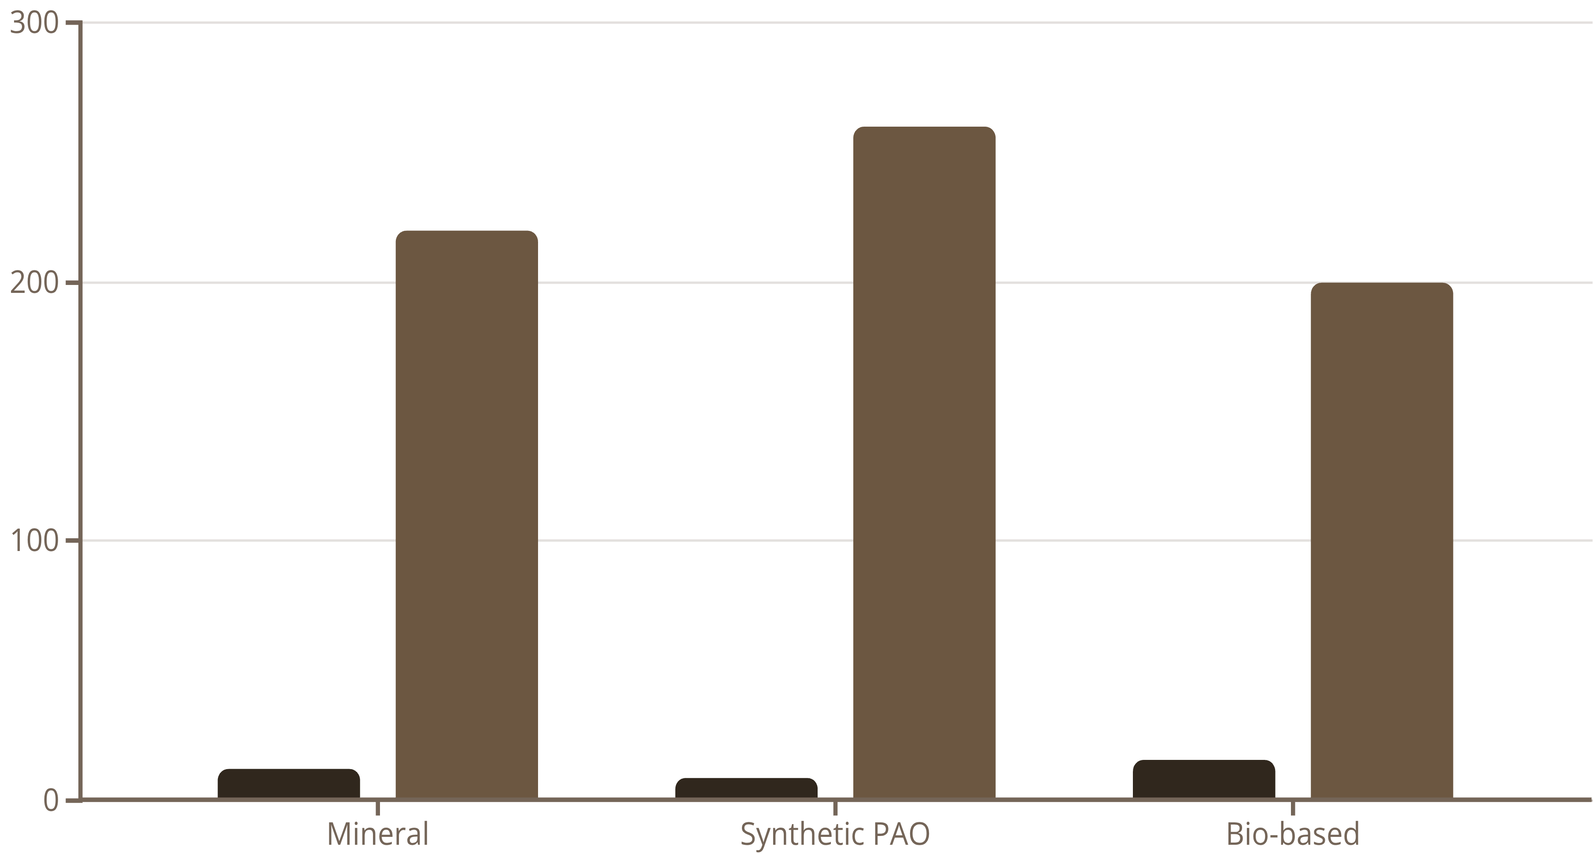
Analyzing Test Results: Comparing Lubricant Types
Comparing test results across lubricant types reveals performance trade-offs. For instance, mineral oils typically show viscosities of 10-20 cSt at 100°C with flash points around 200-250°C, suitable for standard machinery but prone to oxidation. Synthetic polyalphaolefins (PAOs) offer 5-15 cSt viscosity, flash points exceeding 250°C, and superior stability, ideal for aerospace. Bio-lubricants may have lower flash points (180-220°C) but excellent pour points below -30°C for eco-sensitive uses.
High-viscosity, high-flash-point lubricants excel in heavy-duty engines under extreme heat, reducing evaporation losses. Low pour point options, like those with -40°C ratings, prevent flow issues in cold climates, avoiding startup failures. Analysis involves plotting data on viscosity-temperature charts and safety indices, highlighting how additives modify behaviors. For example, zinc-based anti-wear additives boost load capacity in mineral oils, closing gaps with synthetics. This comparative approach informs selections, balancing cost, performance, and application needs to optimize machinery efficiency and lifespan.
Viscosity at 100°C (cSt)
Flash Point (°C)
Bar chart comparing key metrics; synthetics lead in thermal safety.

Slide 8
Evaluating Lubricant Suitability for Engines
Assessing lubricant fit for engines involves matching properties to real-world demands like temperature fluctuations, RPMs, and loads. High-viscosity index (VI) oils maintain film strength across ranges, preventing boundary lubrication failures. Anti-wear and anti-corrosion additives, such as EP (extreme pressure) compounds, protect against scoring in high-load zones like cams and pistons.
ASTM D2266 four-ball wear tests simulate contact, yielding scar diameters; values below 0.9 mm indicate excellent protection, as seen in premium formulations averaging 0.87 mm. Consider oxidation stability for long drains—poor performers form sludges, clogging filters. For diesel engines, low pour points ensure cold cranking, while high flash points mitigate fire risks in turbocharged setups. Holistic evaluation includes compatibility with seals and emissions systems. By prioritizing these, engineers achieve 20-30% extended intervals, cutting downtime and costs while enhancing fuel efficiency.
Validate with Tests
Match Key Properties
Use ASTM standards for wear and stability.
Assess Operating Conditions
Select based on viscosity, points, and additives.
Review temperature, speed, and load profiles.
Pro Tip: Always cross-reference OEM specs for best results.

Slide 9
Case Study: Selecting Grease for Industrial Bearings
In a heavy manufacturing plant, selecting grease for ball bearings under high radial loads and 150°C temperatures proved crucial. NLGI Grade 2 lithium-complex grease was chosen for its balance of pumpability and structure, tested via ASTM D217 penetration (265-295 mm/10) confirming medium consistency. Dropping point exceeded 500°F, ensuring no liquefaction during operation.
Further tests included four-ball EP (ASTM D2596) for load-wear index and water washout resistance, showing only 2% loss—vital for humid environments. Implementation reduced bearing failures by 40%, extending mean time between failures (MTBF) from 6 to 12 months. This case highlights how targeted testing aligns grease properties with demands, minimizing lubrication-related downtime. Cost savings reached 25% through fewer repairs, underscoring the ROI of rigorous evaluation. Similar approaches apply to conveyor or pump bearings, emphasizing compatibility and relubrication intervals.
Test Results
Outcomes: Reduced maintenance by 40%, extended bearing life.
Penetration: 280 (Grade 2)
Dropping Point: 520°F
Washout: 1.5% loss
Wear Scar: 0.45 mm

Slide 10

Summary and Recommendations
Lubricant testing is indispensable for guaranteeing mechanical reliability and operational excellence. By mastering properties like viscosity, flash point, and pour point, along with using precise equipment and analytical comparisons, professionals can select lubricants that precisely match application needs. This not only boosts efficiency and safety but also curtails maintenance expenses through predictive insights.
Key takeaways: Prioritize ASTM-standardized tests for objective data; integrate results with field trials for validation; and consider environmental factors for sustainable choices. Recommendations include routine monitoring programs, staff training on equipment, and collaboration with suppliers for custom formulations. Ultimately, informed lubricant selection transforms potential breakdowns into seamless performance, fostering innovation in industrial practices. For optimal results, combine lab data with real-world pilots to refine selections continually.
1
Conduct Comprehensive Testing
2
Align with Application Needs
3
Monitor and Adapt
Use data to improve over time.
Regularly evaluate all key properties.
Customize based on usage conditions.
Adopt these practices to enhance machinery lifespan and efficiency.

