Slide 1
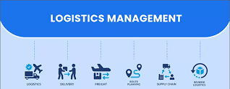
Basic knowledge of logistics monitoring and control activities
Introduction
Monitoring : Monitoring is the process of observing, checking, and recording logistics activities such as transportation, warehousing, and distribution.
Control : Control involves comparing actual performance with the planned targets and making necessary corrections.

Slide 2
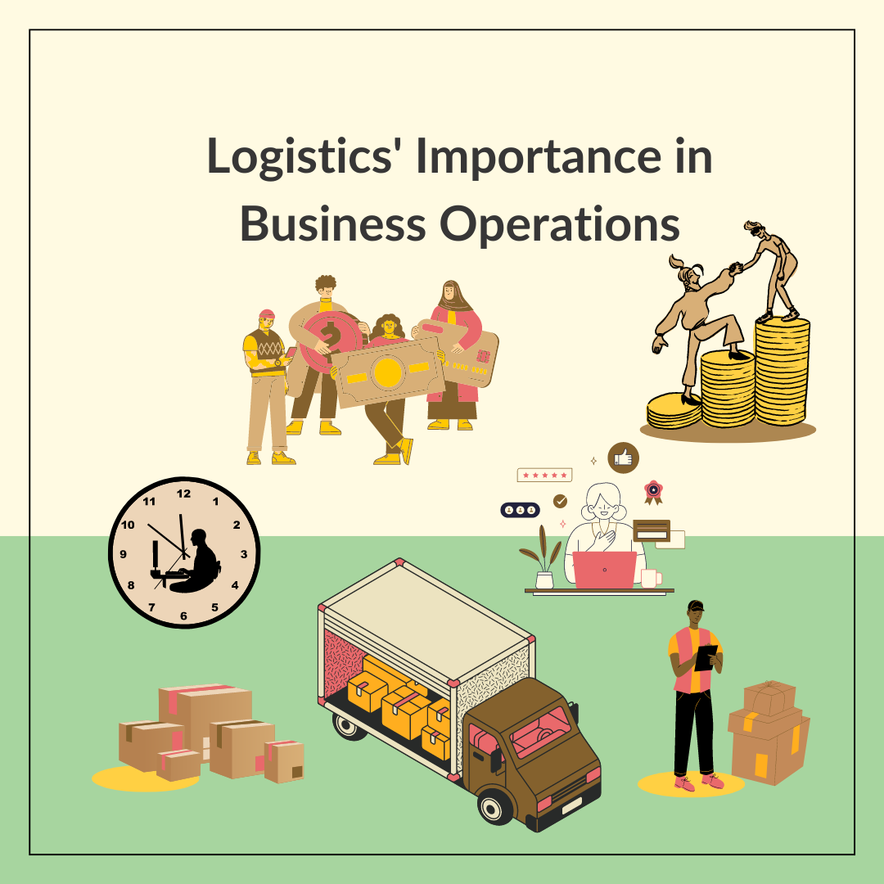
Importance in Logistics
Tracking refers to monitoring the movement of goods and information.

Slide 3
Key Activities to Monitor and Control
Control refers to ensuring that processes follow the plan.

Slide 4
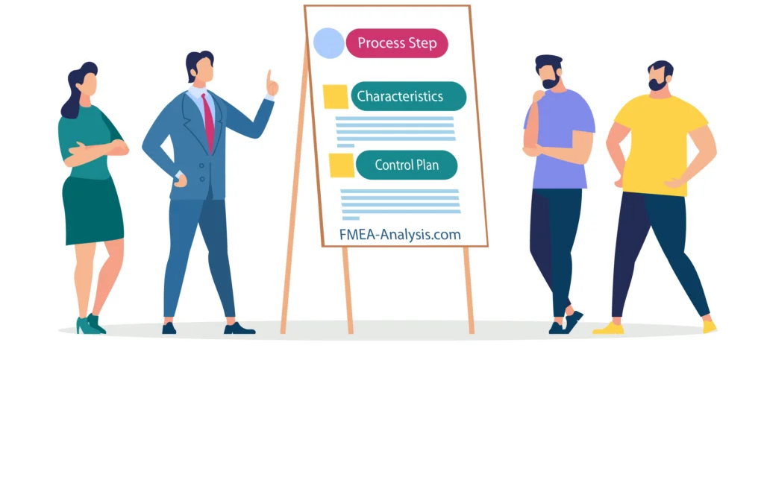
Objectives of monitoring and control
To ensure accuracy, safety, and efficiency in logistics.

Slide 5
Tools Used for Monitoring and Control
RFID, GPS, Barcode Such as RFID, GPS, Barcode

Slide 6
Control system in logistics activities
Such as WMS, TMS systems

Slide 7
Common problems in monitoring and control
Incomplete data, miscommunication

Slide 8
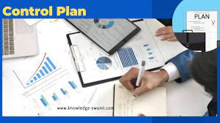
Troubleshooting guidelines
Apply appropriate technologies and train staff

Slide 9
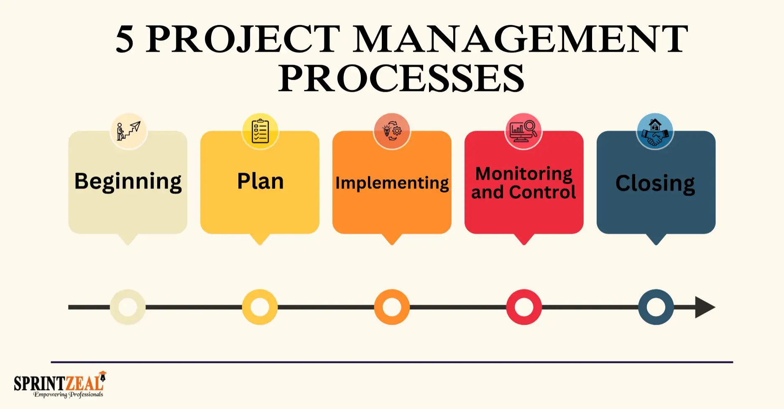
Study cases
Study cases of companies that succeeded in logistics control

Slide 10
สรุปและกิจกรรมในชั้นเรียน
Discussion and group exercises

