Slide 1
Identifying gaps and ways to improve logistics activities

Slide 2
Identifying Gap and Improving Logistics Activities
Introduction to the concept of gaps and improvement in logistics activities

Slide 3
Meaning of “Gap”
A logistics gap is the difference between the current state and the desired objective.

Slide 4
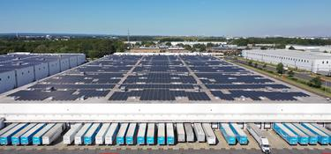
Types of Gap in Logistics
Process Gaps
Data Gaps
Personnel Gaps

Slide 5
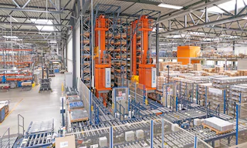
How to Identify Gap
Work observation
Stakeholder interviews
Report/metric analysis

Slide 6
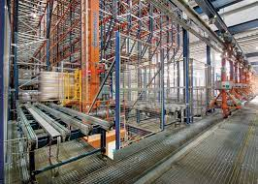
Using SWOT in Gap Analysis
Use of Strengths, Weaknesses, Opportunities, and Threats to analyze internal and external factors

Slide 7
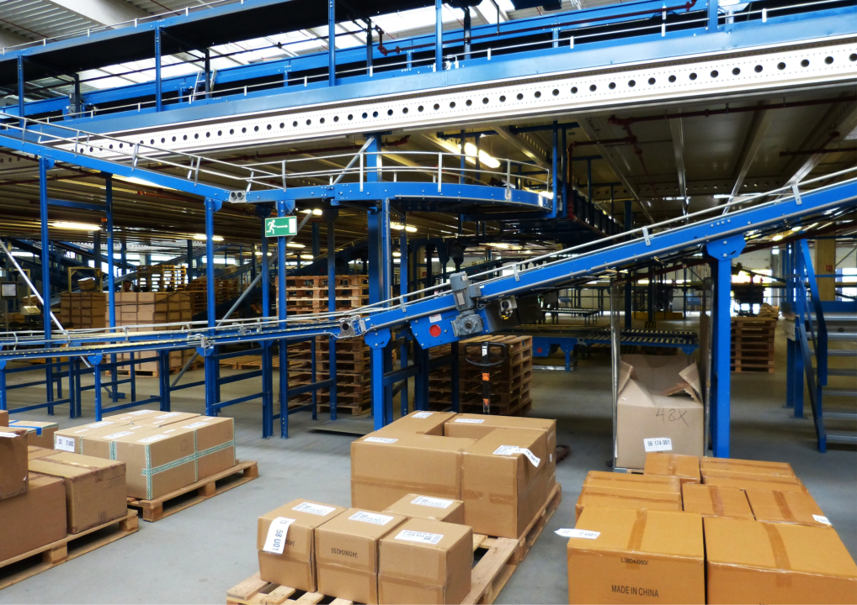
Determining Improvement Approach
Evaluate alternatives
Choose the most suitable
improvement method

Slide 8
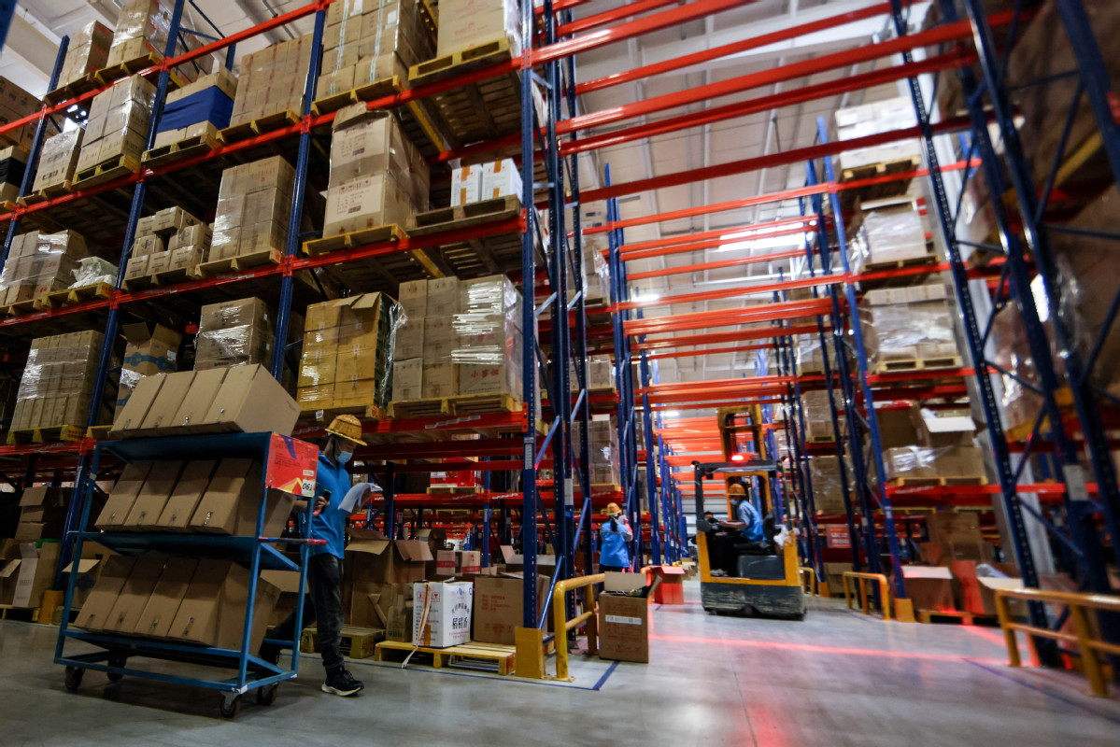
Assessing the Impact of Gap
Consider impact on quality, speed, and logistics cost

Slide 9
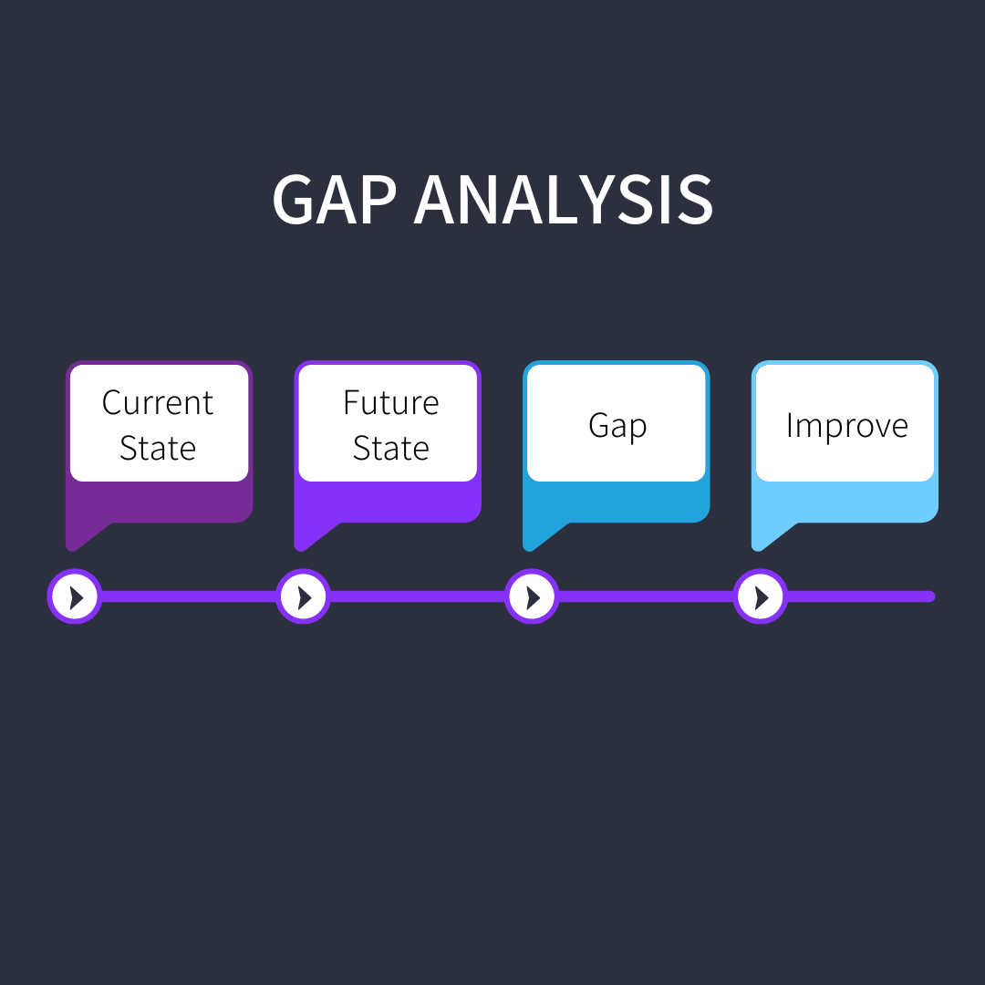
Logistics Improvement Tools
PDCA
Lean
Kaizen

Slide 10
Case Study – Warehouse Gap
Real case of improper storage arrangement and possible improvements

Slide 11
Summary and Discussion
Students identify gaps in real workplaces and propose improvement strategies

