Slide 1
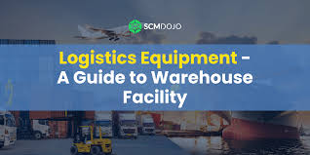
Logistics Facilities and Equipment (31401-2006) สิ่งอำนวยความสะดวกและอุปกรณ์ทางโลจิสติกส์
Unit 1: Basic Knowledge of Logistics Processes and Facilities (หน่วยที่ 1: ความรู้เบื้องต้นเกี่ยวกับกระบวนการโลจิสติกส์และสิ่งอำนวยความสะดวก)

Slide 2
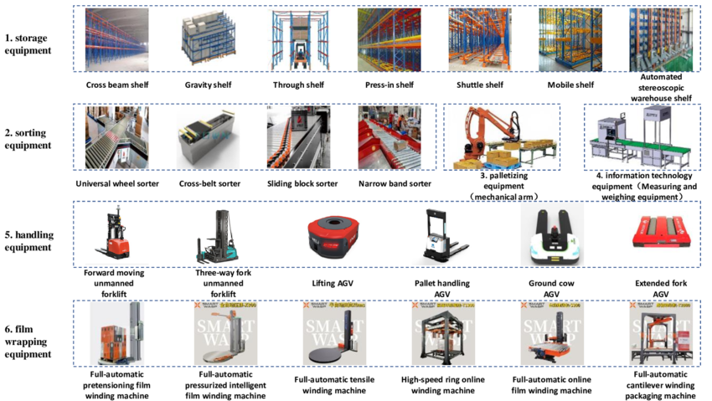
Basic Knowledge of Logistics Processes and Facilities

Slide 3
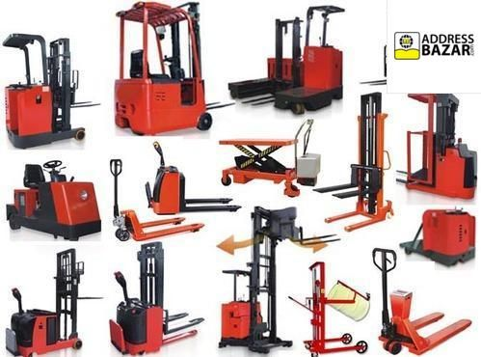
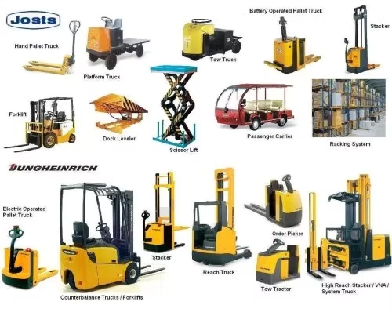
Logistics Definition
Logistics is the planning, control, and management of the movement of goods, services, and information.

Slide 4
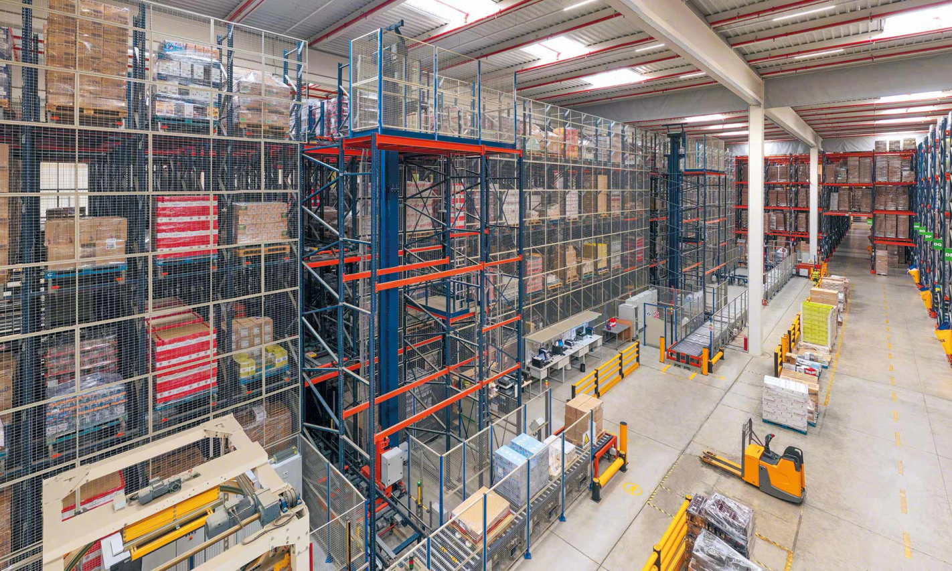
Objectives of Logistics
The main objectives of logistics are cost reduction, service quality improvement, and increased customer satisfaction.

Slide 5
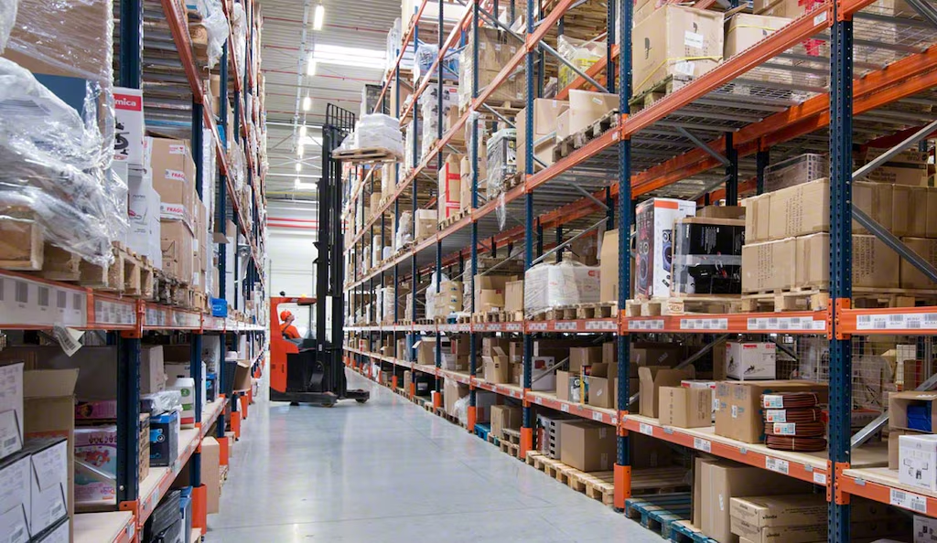
Key Logistics Activities
Key logistics activities include procurement, transportation, storage, and distribution.

Slide 6
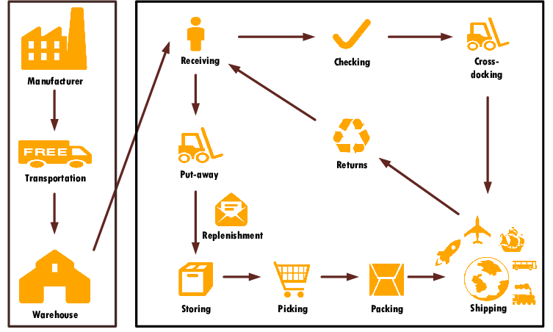
Logistics Process Flow
The logistics process flows from suppliers to factories, warehouses, and finally to customers.

Slide 7
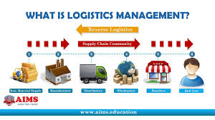
Definition of Facilities in Logistics
Facilities in logistics refer to buildings, equipment, and systems that support logistics activities.

Slide 8
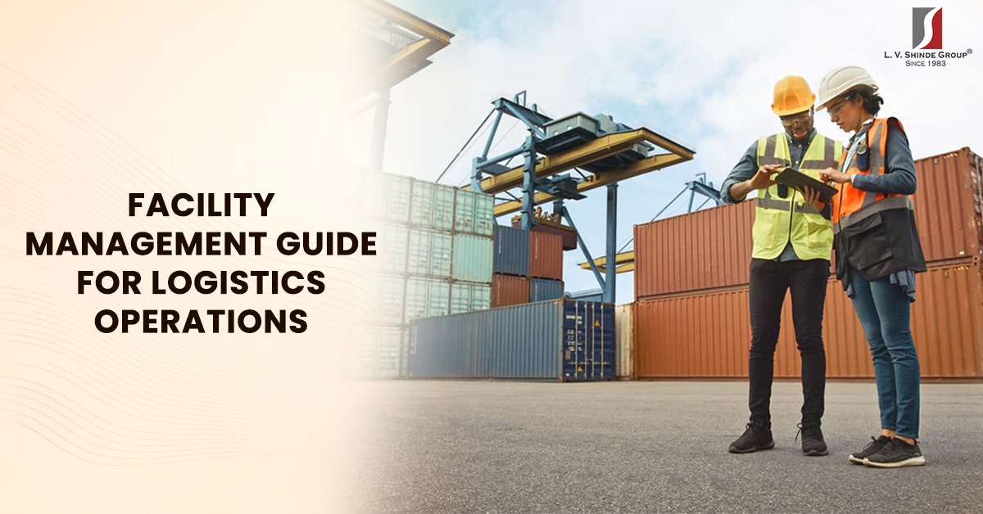
Types of Logistics Facilities
Types of logistics facilities include warehouses, distribution centers, an

Slide 9
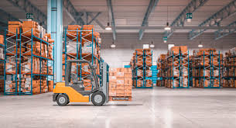
Warehouse Functions
Warehouses store, prepare, and support the distribution of goods.

Slide 10
Importance of Logistics Facilities
Facilities improve efficiency, reduce delivery time, and lower costs.

Slide 11
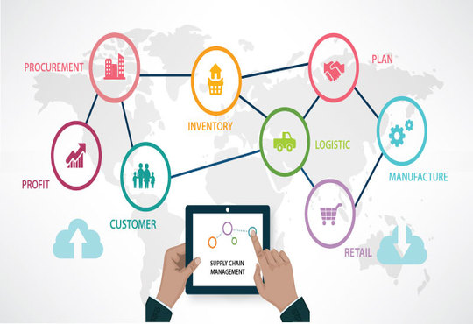
Technology in Logistics Facilities
like WMS and RFID enable efficient warehouse tracking and management.

Slide 12
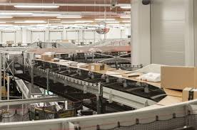
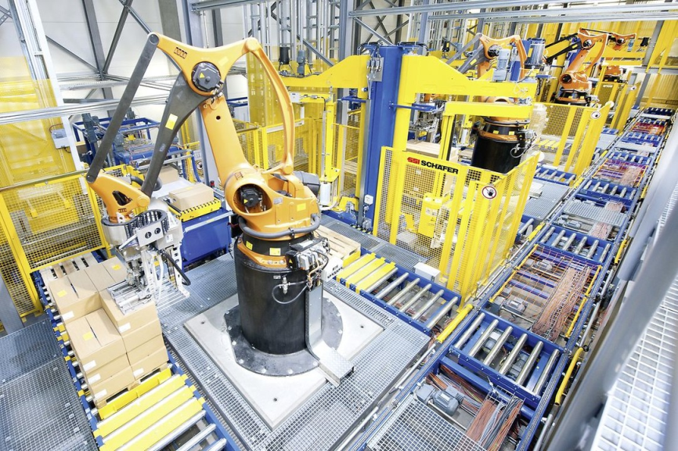
Case Example
Example: A company uses an automated distribution center to reduce delivery times.

