Slide 1
Demand and Supply Planning in Supply Chain (31401-2010)

Slide 2
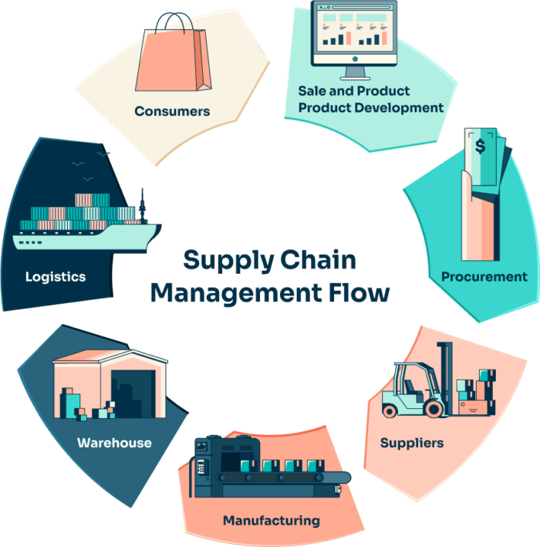
Unit 1: Economic Principles and Demand Forecasting
Introduction to Economics in Supply Chain Economics supports decision-making on resources and demand in the supply chain.

Slide 3
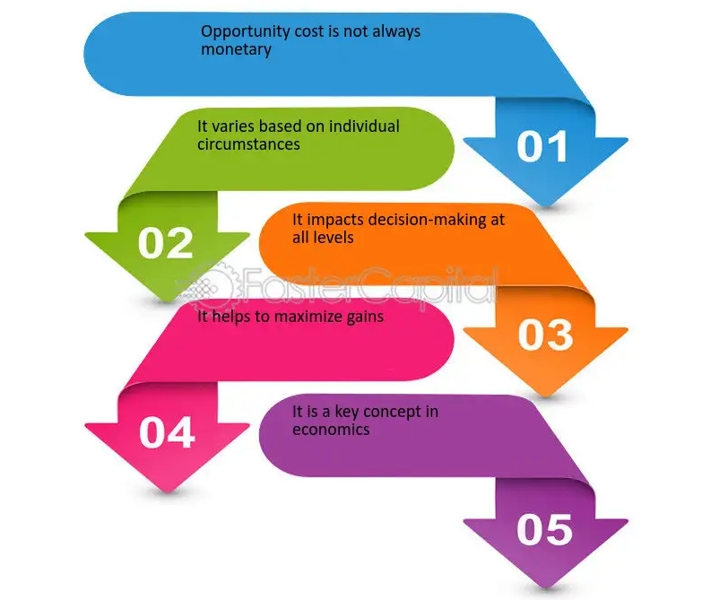
Basic Economic Concepts
Demand, supply, cost, opportunity, and decision-making are key concepts.

Slide 4
Demand in Economics
Demand is the quantity of goods/services consumers are willing to buy at a price.

Slide 5
Supply in Economics
Supply is the quantity of goods/services producers are willing to sell at a price.

Slide 6
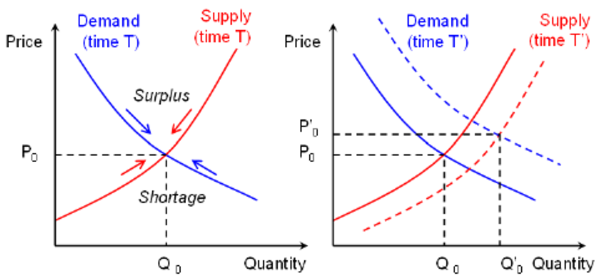
Market Equilibrium
Equilibrium is the point where demand and supply meet, creating stable prices.

Slide 7
What is Demand Forecasting?
Demand forecasting is predicting future customer demand.

Slide 8
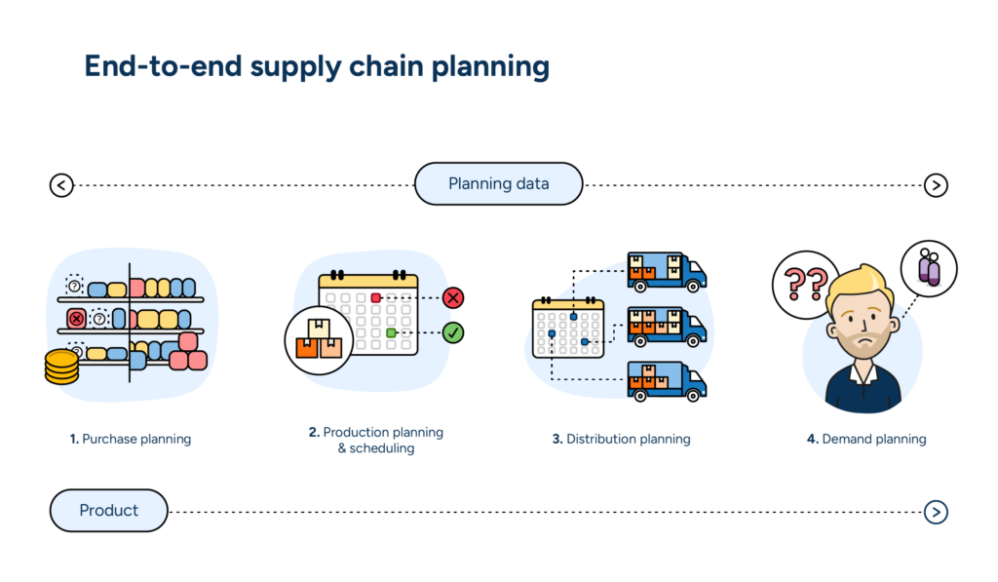
Importance of Forecasting
Helps in planning production, procurement, and distribution efficiently.

Slide 9
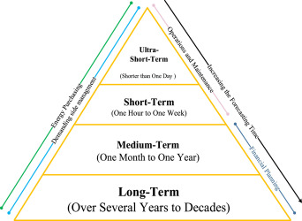
Types of Demand Forecasting
Divided into short-, medium-, and long-term forecasts using different data.

Slide 10
Qualitative Methods
Based on expert opinions or market experience.

Slide 11
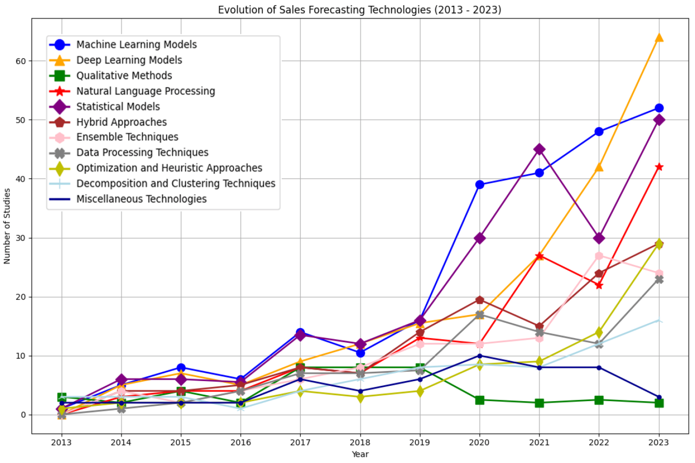
Quantitative Methods
Uses numerical data, historical sales, and statistical models.

Slide 12
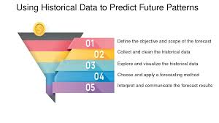
Time Series Forecasting
Analyzes past data trends to forecast the future.

Slide 13
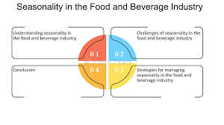
Factors Affecting Demand Forecast
E.g., seasonality, promotions, economic conditions, and competitors.

Slide 14
Case Study & Activity
Students choose one product and try forecasting its demand.

