Slide 1
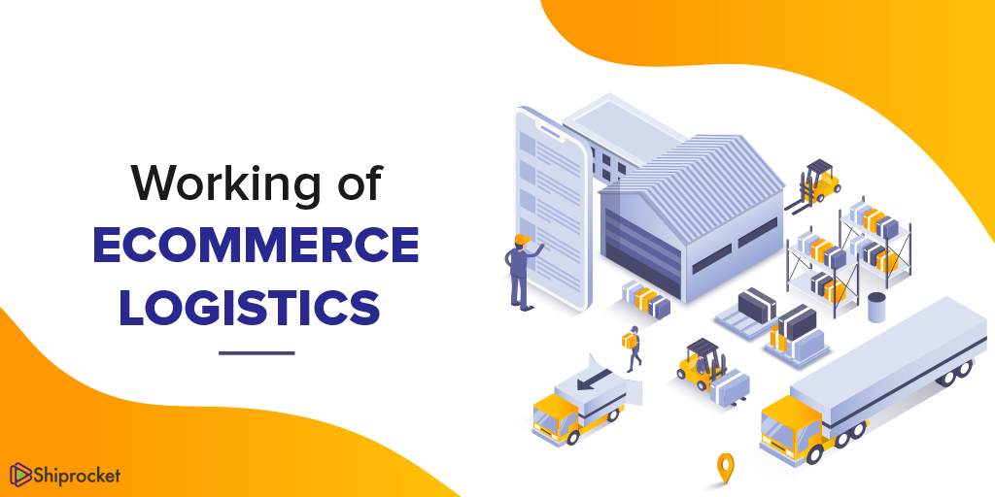
Unit 1: Introduction to Logistics for E-Commerce

Slide 2
Meaning of E-Commerce
Buying and selling goods and services through electronic platforms such as the internet or mobile apps.

Slide 3
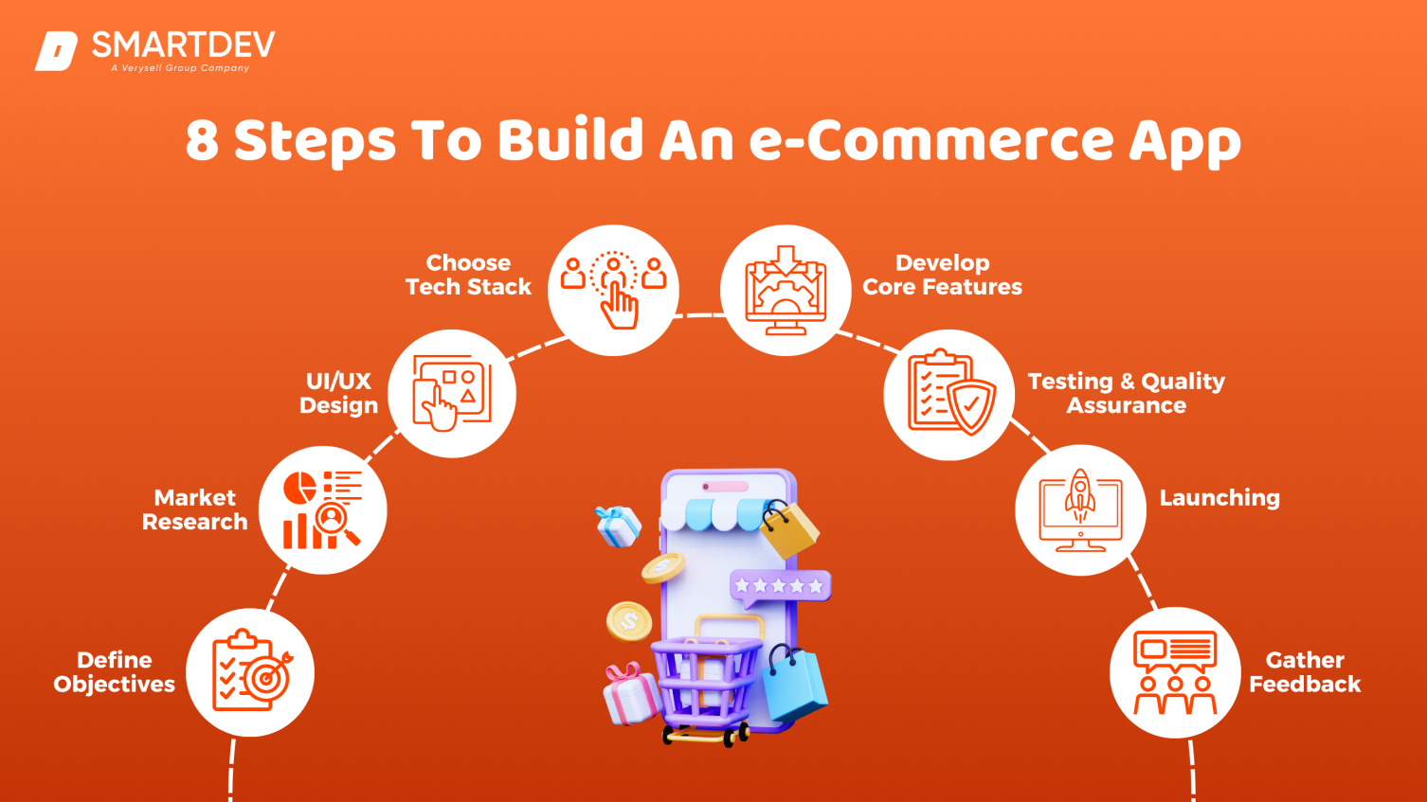
Importance of Logistics in E-Commerce
Logistics plays a crucial role in fast delivery and customer satisfaction.

Slide 4
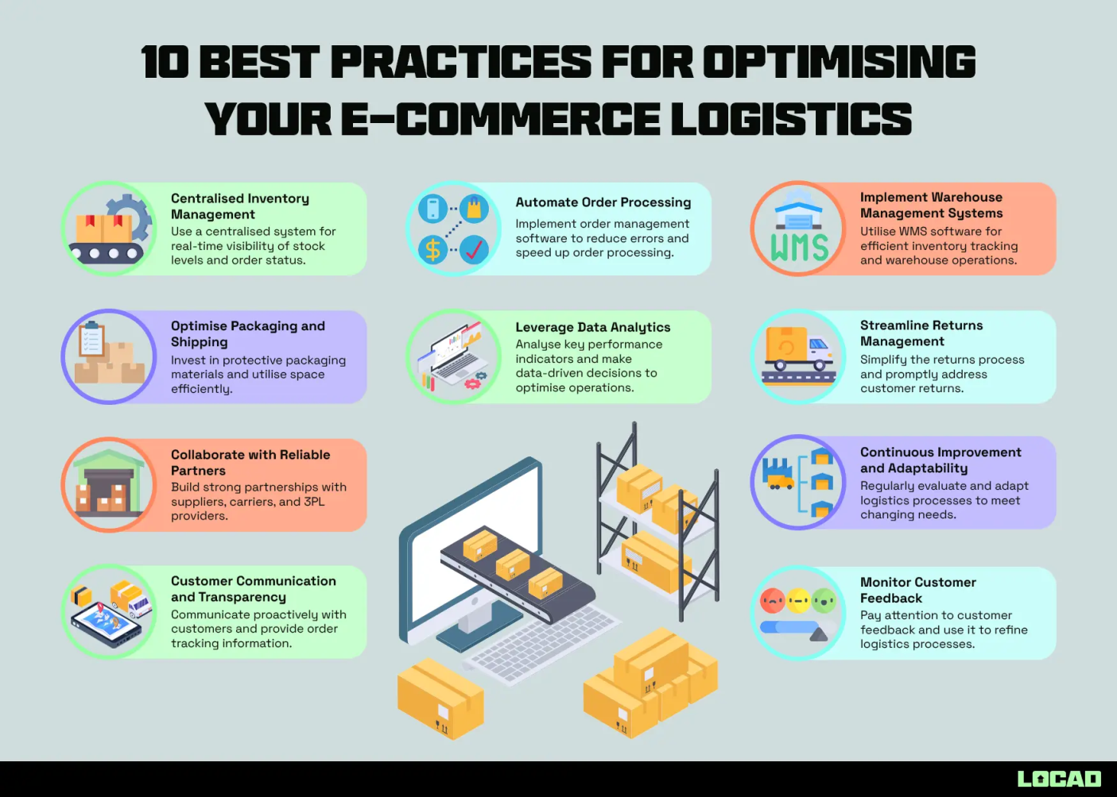
Difference between Traditional Logistics and E-Commerce
E-Commerce logistics handles small orders in high volumes, unlike traditional bulk shipments.

Slide 5
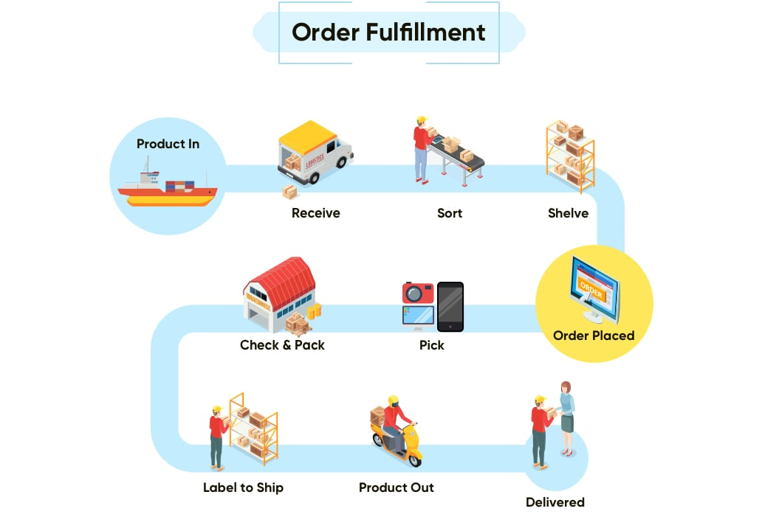
Logistics Process in E-Commerce
Starts with order receipt → warehousing → packing → shipping → delivery.

Slide 6
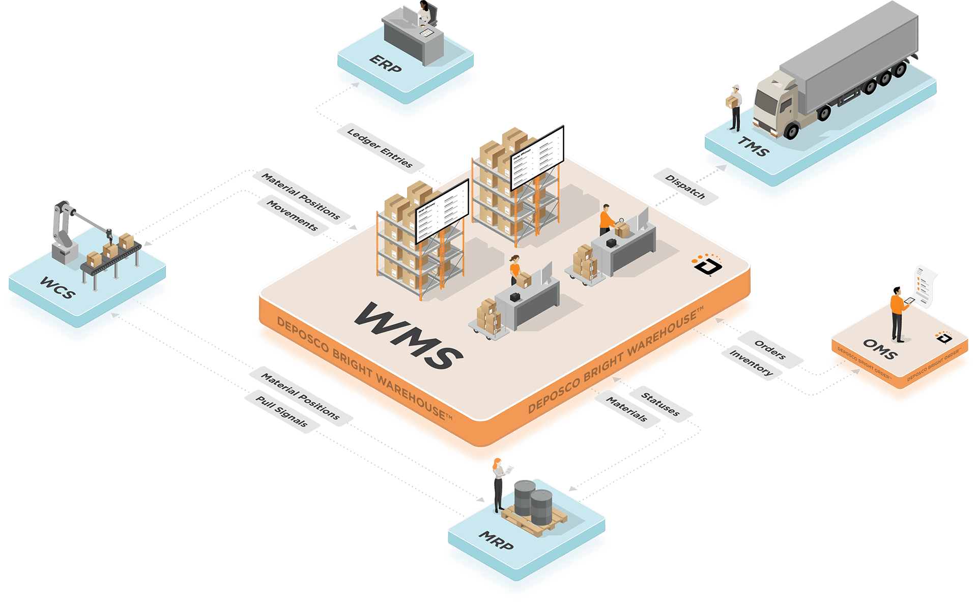
Role of E-Commerce Warehouse
Warehouses must support quick dispatch and often use technology like WMS.

Slide 7
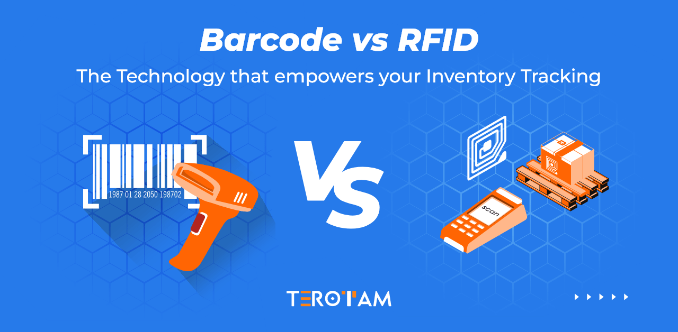
Technologies Used in E-Logistics
RFID, barcodes, GPS, route optimization, and automation systems are commonly used.

Slide 8
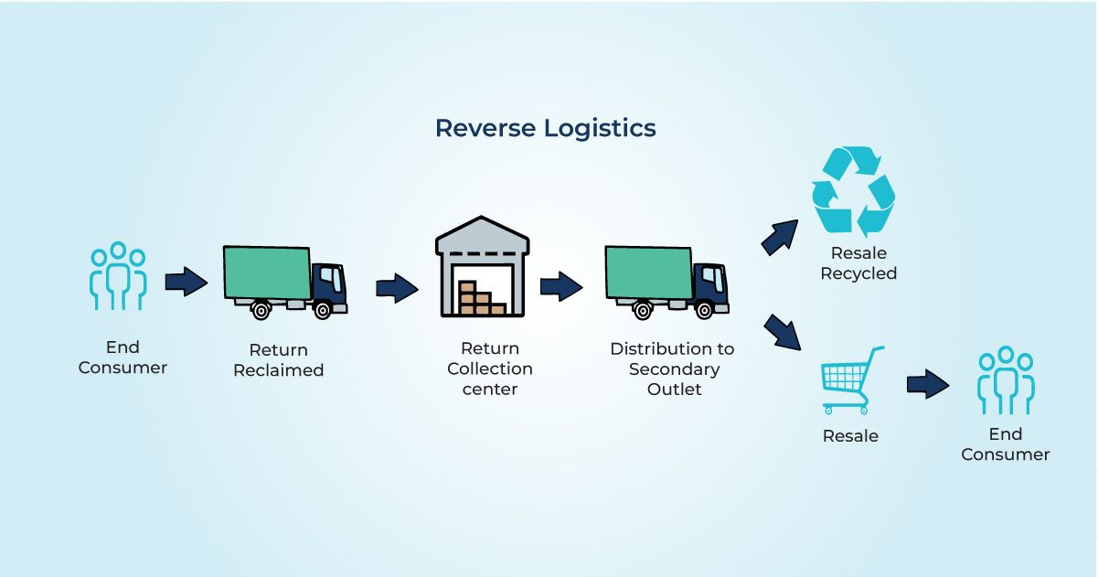
Transportation Models in E-Commerce
Includes last-mile delivery, same-day delivery, and reverse logistics.

Slide 9
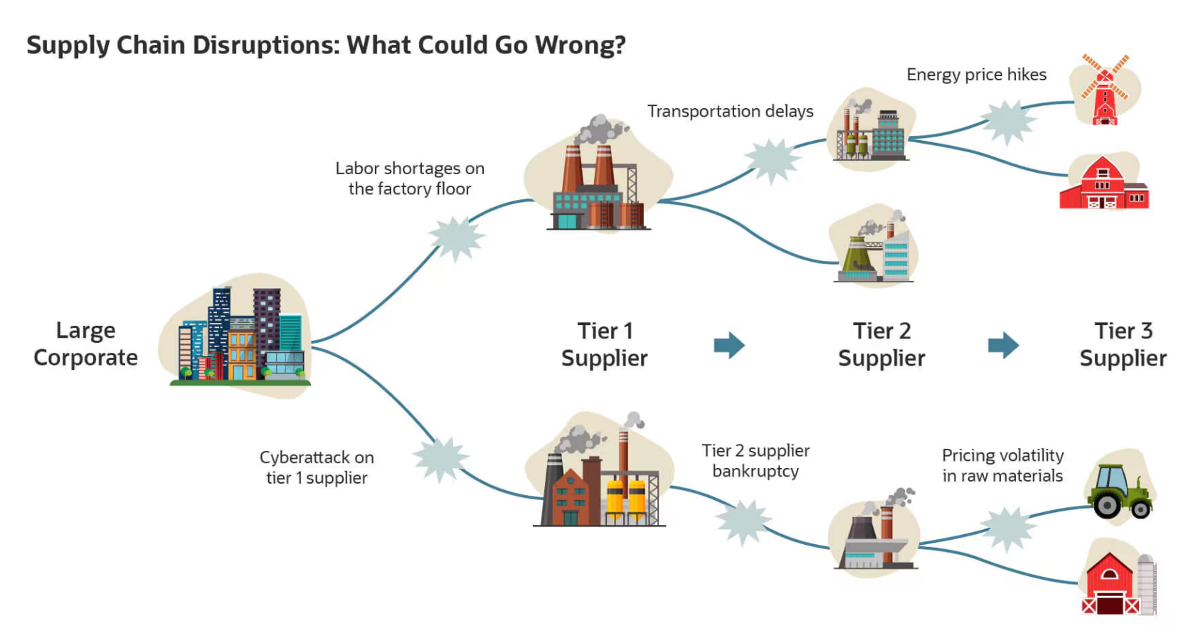
Common Problems in E-Commerce Logistics
Common issues include delays, remote areas, and incorrect deliveries.

Slide 10
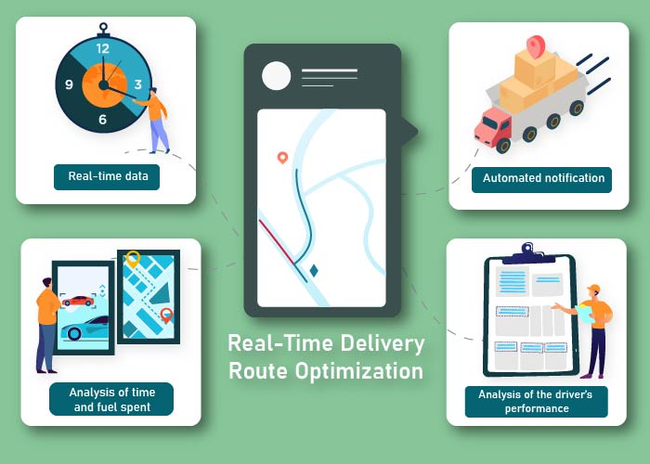
Solutions
Use tracking systems and improve delivery route management.

Slide 11
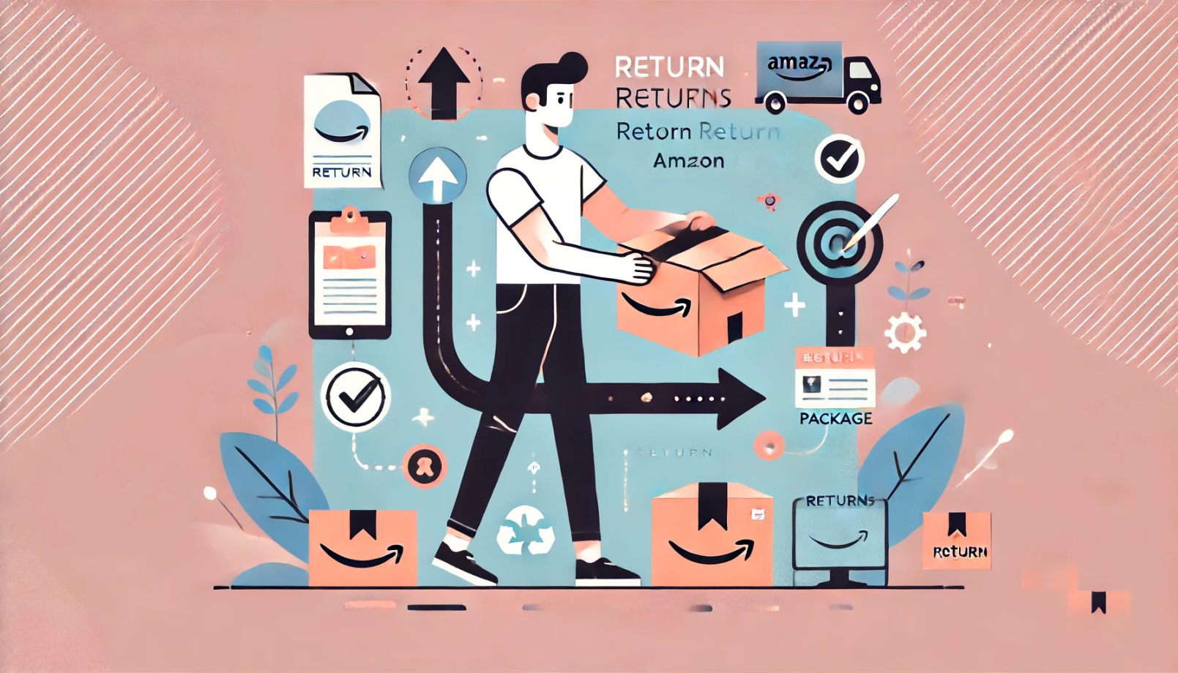
After-sales Service
Includes return services, exchanges, and refunds.

Slide 12
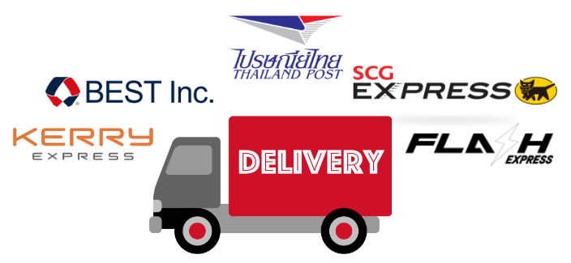
E-Commerce Logistics Providers
Providers like Kerry, Flash, SCG Express, and Thailand Post.

Slide 13
Examples of E-Commerce Logistics Management
Shopee uses fulfillment centers to manage orders and inventory efficiently.

Slide 14
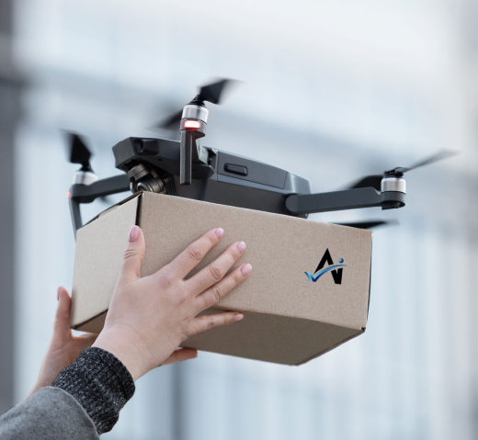
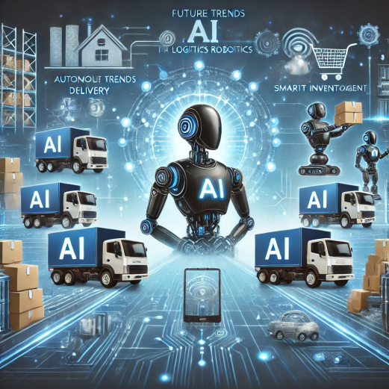
Future Trends in E-Commerce Logistics
Trends include the use of drones, robots, and AI in delivery.

