Slide 1
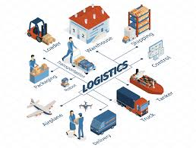
Unit 2: Logistics Models for Online Commerce

Slide 2
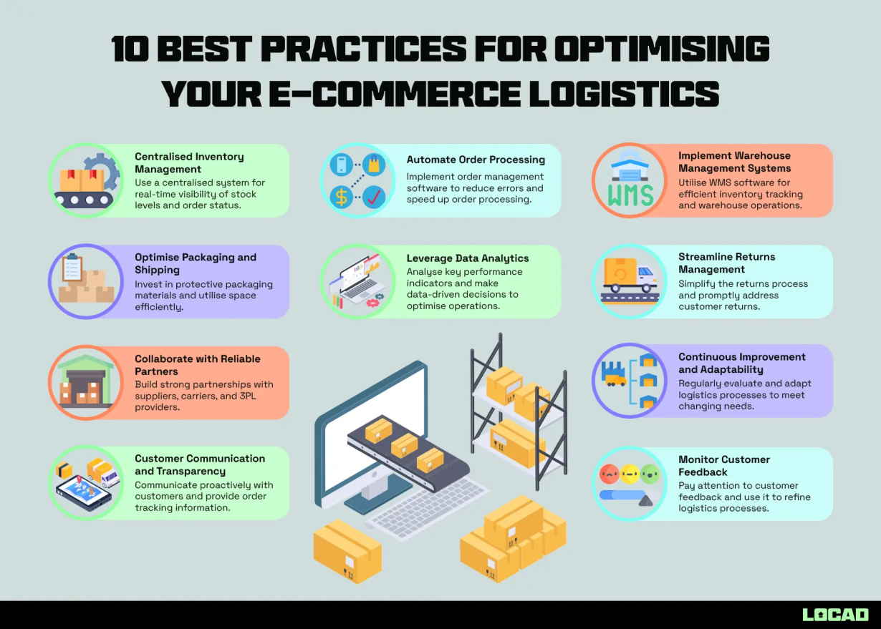
Introduction
Online commerce requires logistics models that differ from traditional ones: fast, flexible, and capable of managing high order volumes.

Slide 3
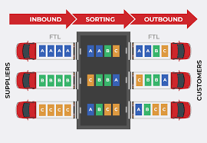
Key Logistics Models in E-Commerce
Includes:
1) Fulfillment center delivery,
2) Cross-docking,
3) Delivery from nearby stores.

Slide 4
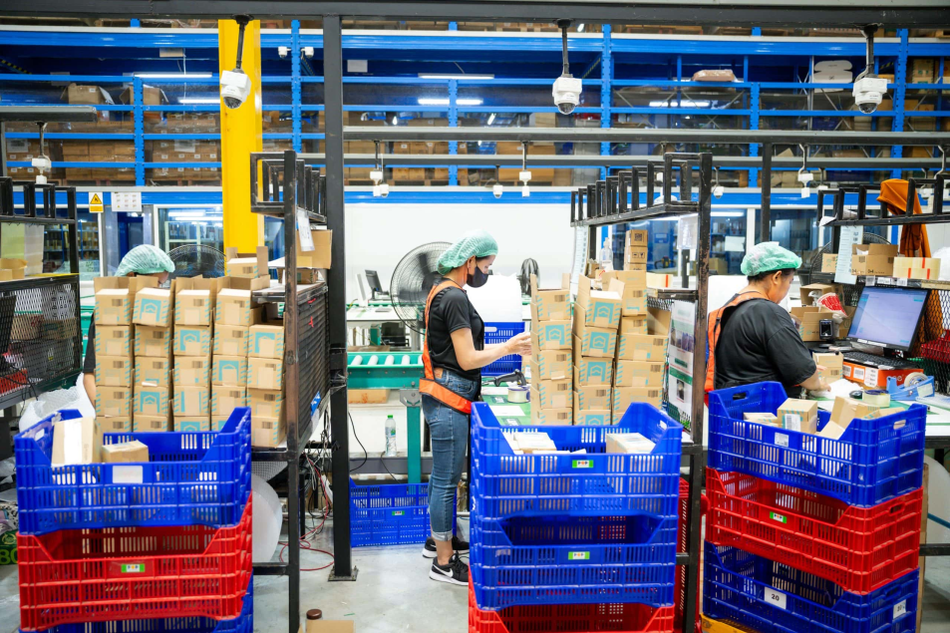
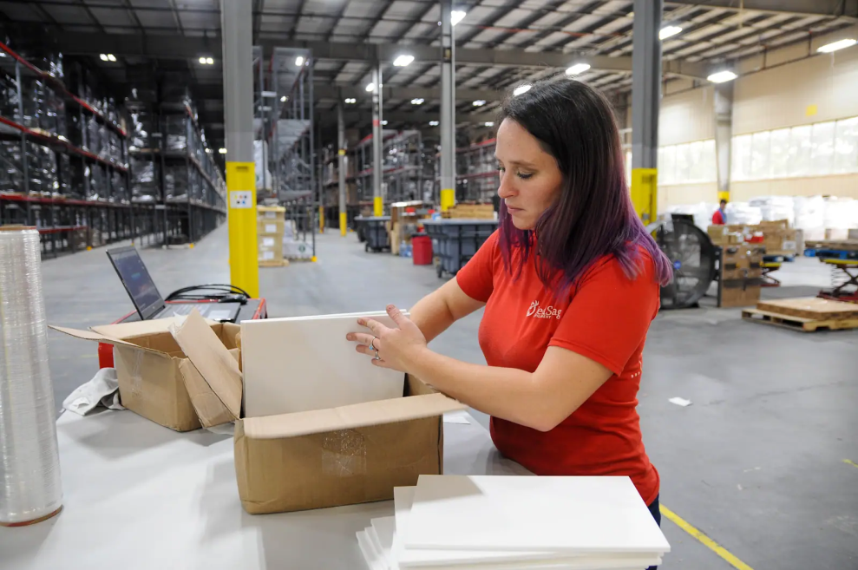
Fulfillment Center Logistics
Products are picked, packed, and shipped from central fulfillment centers (e.g., Lazada, Shopee).

Slide 5
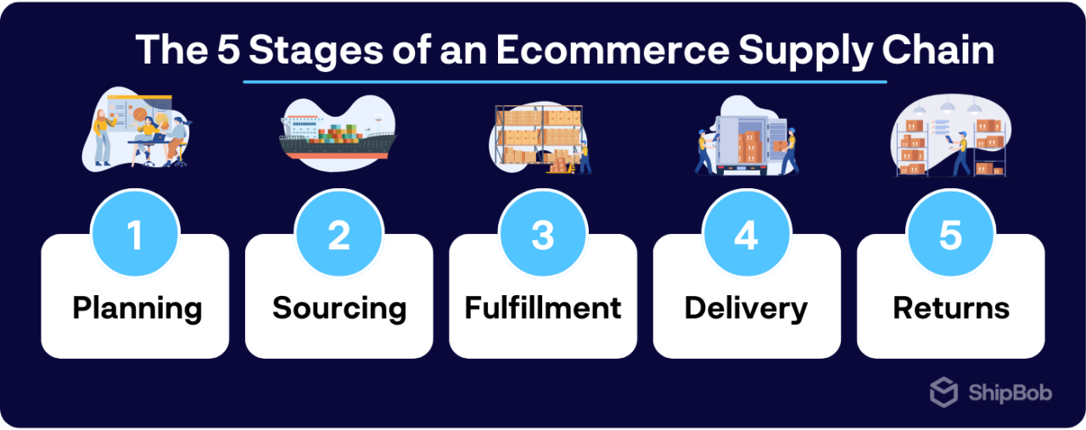
Cross-Docking
Products are not stored but quickly transferred to delivery—reducing storage time.

Slide 6
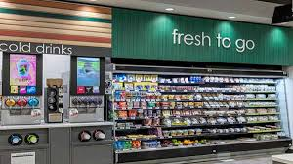
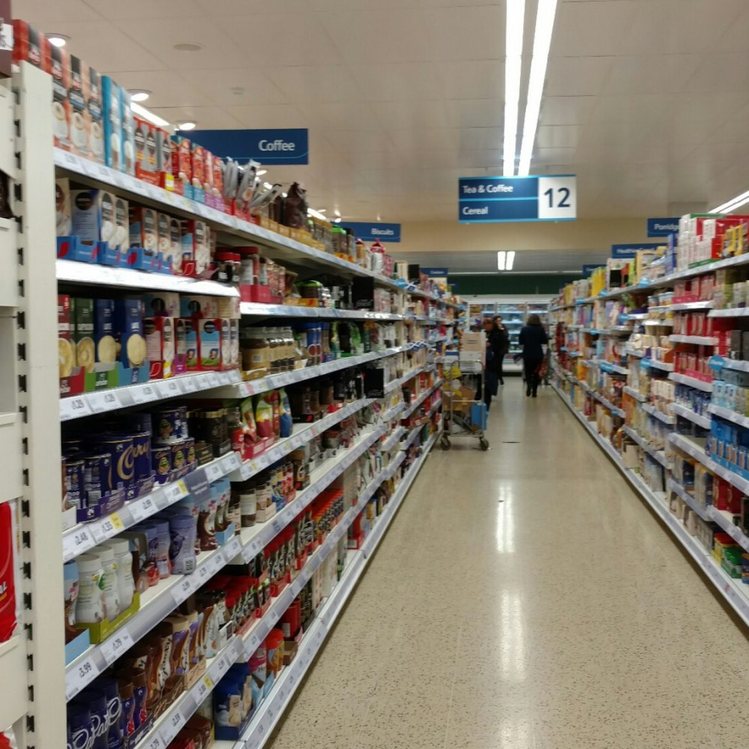
Store-Based Delivery
Local stores act as mini-warehouses (e.g., 7-Eleven, Tesco delivering to homes).

Slide 7
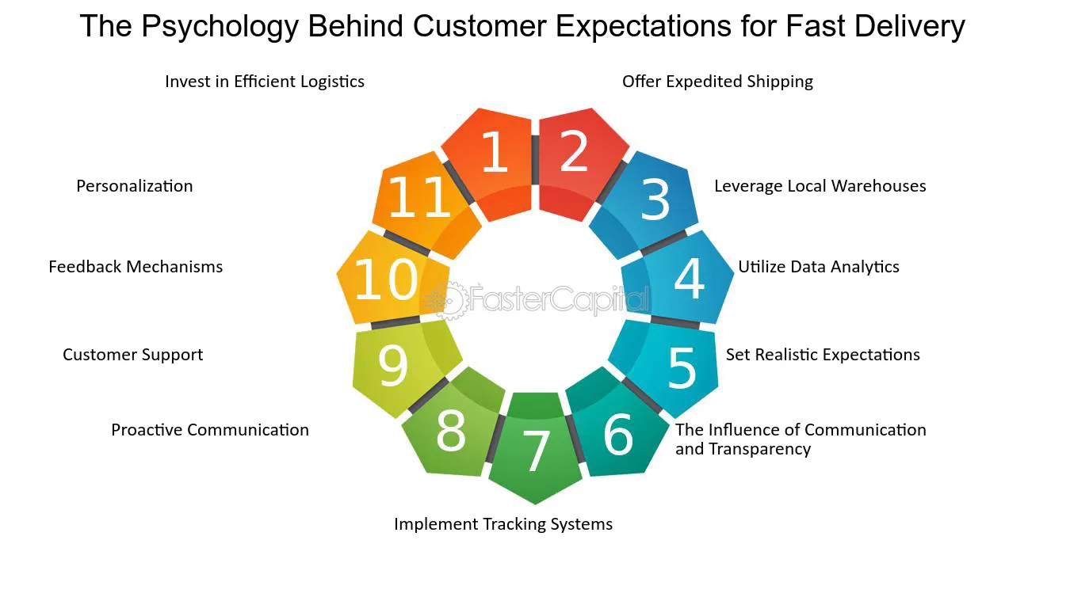
Last-Mile Delivery Model
The final delivery step; requires precision and speed to reach customers.

Slide 8
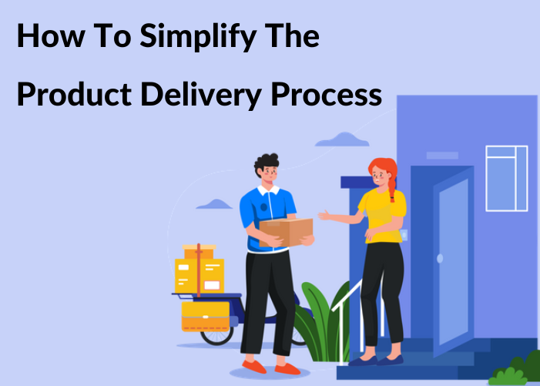
Choosing a Logistics Model
Depends on product type, cost, delivery time, and customer location.

Slide 9
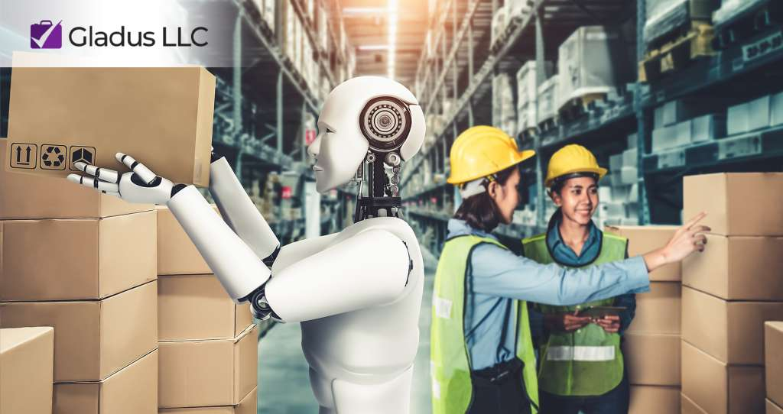
Delivery Models by Country
Developed countries use automation; others still rely heavily on manual labor.

Slide 10
Order Management System (OMS)
Order Management System (OMS) manages multi-channel orders and tracking.

Slide 11
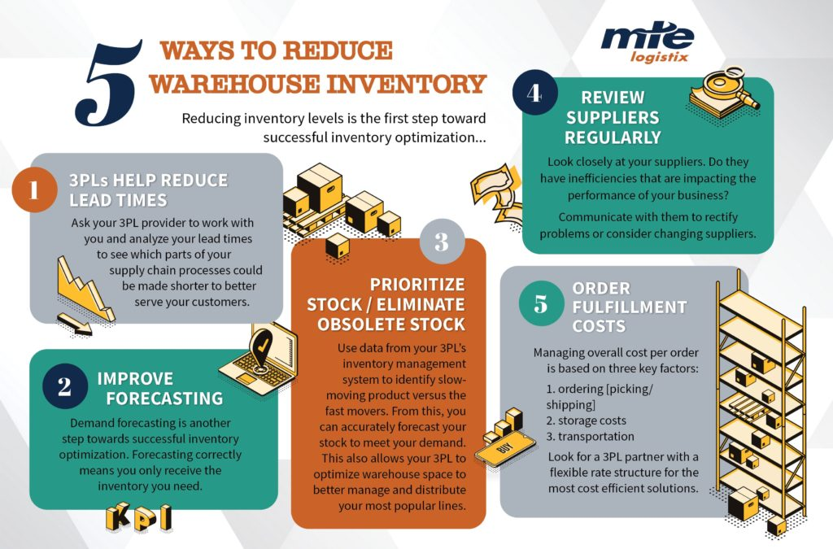
Collaborative Logistics
Companies share warehouses or transport systems to reduce costs.

Slide 12
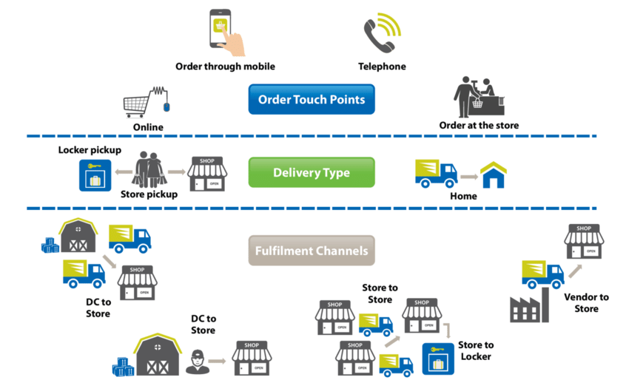
Omnichannel Logistics Management
Integrates all sales channels (online & offline) into one logistics system.

Slide 13
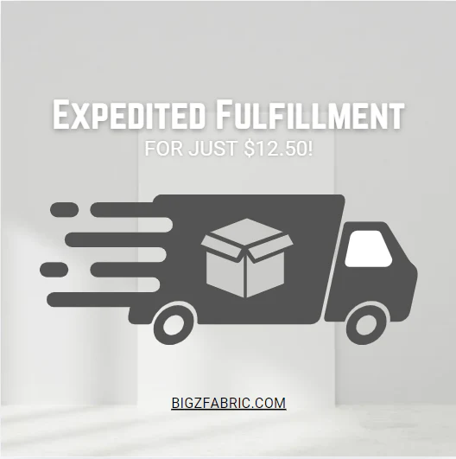
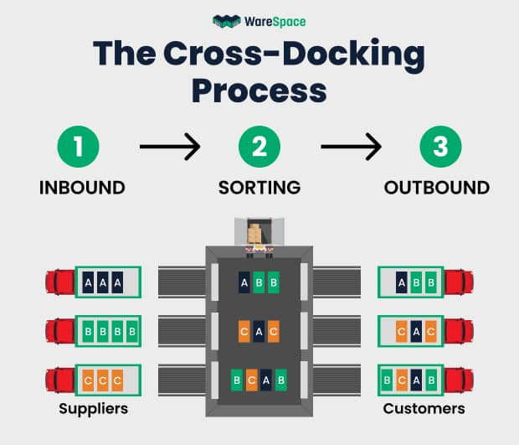
Advantages of Each Model
Fulfillment = fast
Cross-docking = cost-efficient
Store-based = close to customers

Slide 14
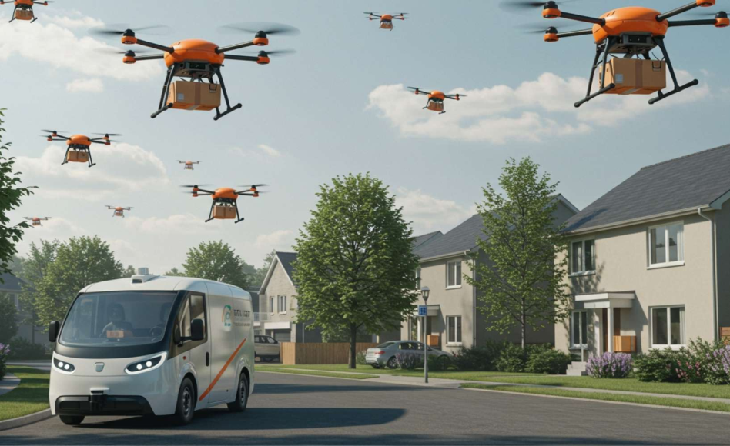
Future Trends
Drones, autonomous vehicles, and AI will increasingly impact E-Logistics.

